Slide 1
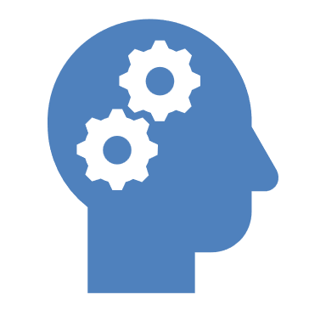

AI Society presented by Alexandru-Sebastian Ene
Diffusion Models: A Deep Dive into Generative AI
Exploring the fundamentals, mathematics, advancements, and applications.
Notes:
Hey everyone, thank you for coming today, and thank you to AI Society for allowing me to present diffusion models to you today. Diffusion models hold a very dear place in my heart as it was one of the first things I had studied all the way back in 2019. Since then the cutting edge has moved very far from the early aspects of GANs. If I was to explain diffusion models in one phrase I would say that they generate data by iteratively refining random noise generation into realistic samples. If you have heard of DALL-E or heard of Trump and Biden speaking together about Minecraft then that’s the working piece behind it. But beside these niche tools there are also very useful real-world tools which we will get more into. Throughout these I will delve through how diffusion models actually work, deeper into the mathematics, the training processes and finally the training model. We will discuss how to generate samples and highlight important architectural components like the unet and try to look at recent advancement. I would like throughout this for anyone to ask any question no matter how dumb you might think the question. By the end of the hour you should have a very good understanding of how this works and you should be able to go home and code these yourselves there is some code examples that I will present near the end.

Slide 2
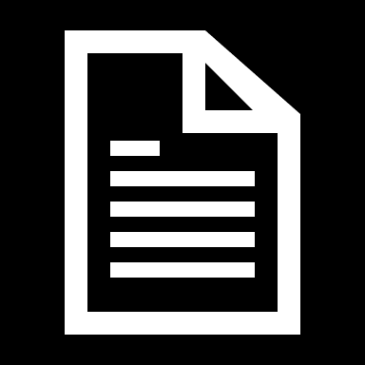
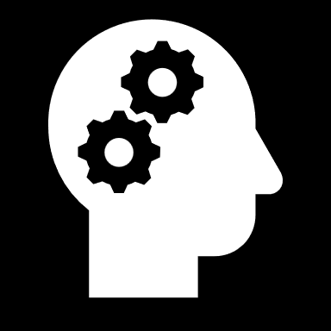
Introduction to Diffusion Models
Definition
Diffusion models are generative models that learn to reverse a gradual noise corruption process to generate data from noise.
Notes:
Hey everyone, thank you for coming today, and thank you to AI Society for allowing me to present diffusion models to you today. Diffusion models hold a very dear place in my heart as it was one of the first things I had studied all the way back in 2019. Since then the cutting edge has moved very far from the early aspects of GANs. If I was to explain diffusion models in one phrase I would say that they generate data by iteratively refining random noise generation into realistic samples. If you have heard of DALL-E or heard of Trump and Biden speaking together about Minecraft then that’s the working piece behind it. But beside these niche tools there are also very useful real-world tools which we will get more into. Throughout these I will delve through how diffusion models actually work, deeper into the mathematics, the training processes and finally the training model. We will discuss how to generate samples and highlight important architectural components like the unet and try to look at recent advancement. I would like throughout this for anyone to ask any question no matter how dumb you might think the question. By the end of the hour you should have a very good understanding of how this works and you should be able to go home and code these yourselves there is some code examples that I will present near the end.

Slide 3
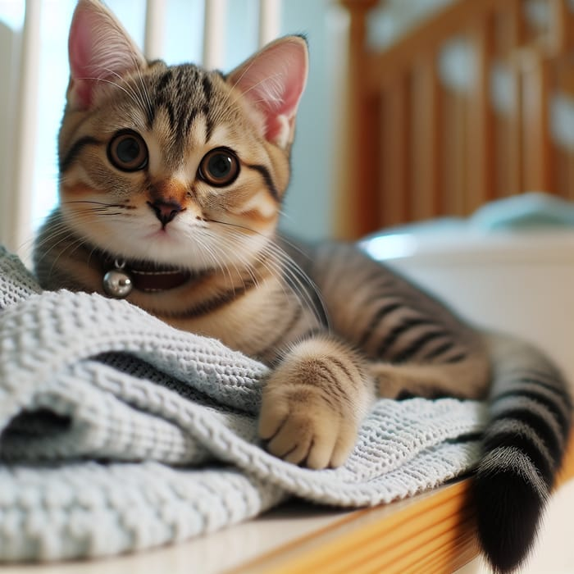
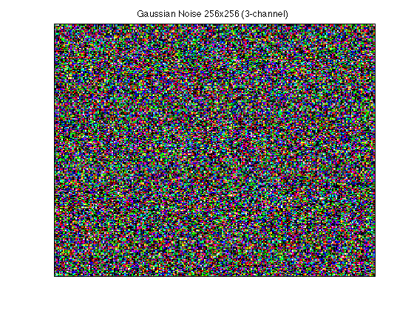
Notes:
Talk about cat
SICK
MEOW MEOW MEOW

Slide 4
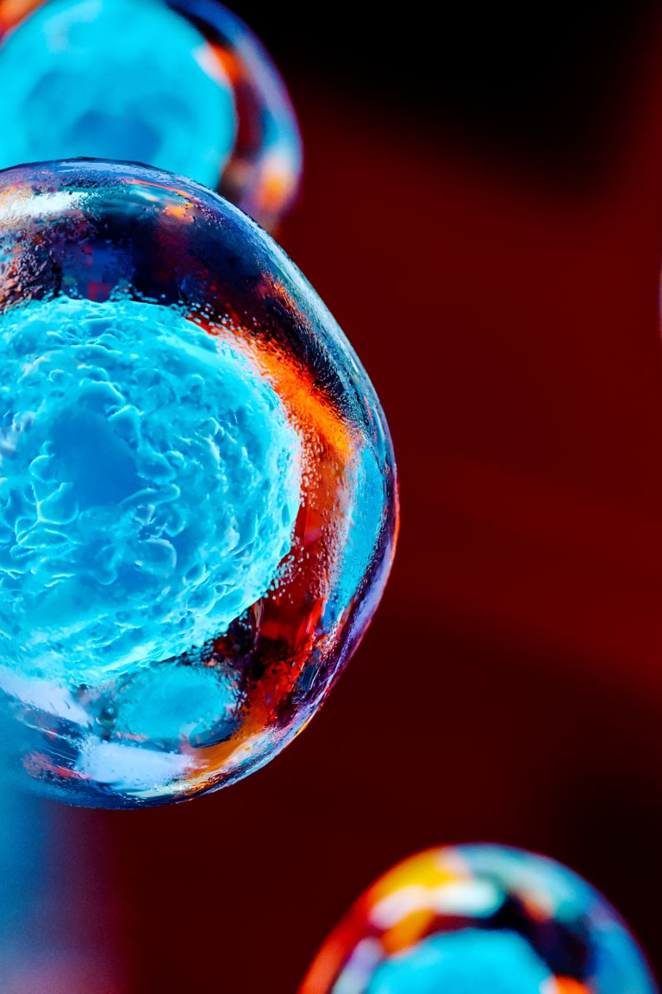
Introduction to Diffusion Models
Inspired by non-equilibrium thermodynamics and probabilistic graphical models.
Notes:
How Diffusion Models Work: A Blend of Physics and Probability
The Big Idea. diffusion models take inspiration from both physics and probability. They start with real data, gradually turn it into noise, and then learn to reverse the process to generate realistic images, audio, or other data types. The Physics Inspiration: Diffusion and Reversal think about how ink spreads in water—it slowly mixes and loses its original shape. This is diffusion, a process where things move from order to disorder. Diffusion models work in a similar way. They take an image or some data and slowly add noise to it over many small steps until all structure is lost, leaving only randomness. The key idea is that the model learns to reverse this process, step by step, to recreate meaningful data from pure noise. This concept comes from non-equilibrium thermodynamics, which studies how systems change over time. The Probability Inspiration: A Chain of Small Steps. Another way to understand diffusion models is through probabilistic modeling. Instead of thinking about the process as a single transformation, we can break it down into many small steps. Each step adds a little bit of noise, and every new version of the data depends only on the one before it. This follows a common principle in probability called a Markov chain, where future states depend only on the present, not the past. By structuring the problem this way, researchers could apply well-established probability techniques to train these models efficiently. Why This Matters. Diffusion models are powerful because they combine a simple physics idea—how things break down over time—with a structured probability framework that makes learning and generation efficient. This balance of physical intuition and mathematical structure is why they work so well and why they’ve become one of the leading methods for generating high-quality images and other media today.

Slide 5
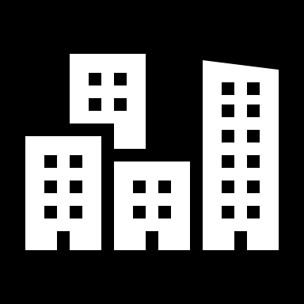
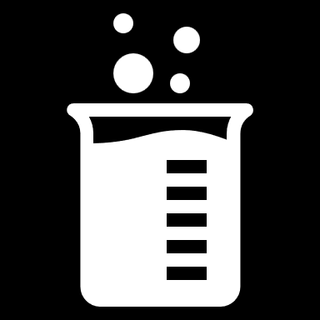
Introduction to Diffusion Models
Applications
Used in image generation (DALL·E, Stable Diffusion), audio synthesis, and molecular design.
Notes:
How Diffusion Models Work: A Blend of Physics and Probability
The Big Idea. diffusion models take inspiration from both physics and probability. They start with real data, gradually turn it into noise, and then learn to reverse the process to generate realistic images, audio, or other data types. The Physics Inspiration: Diffusion and Reversal think about how ink spreads in water—it slowly mixes and loses its original shape. This is diffusion, a process where things move from order to disorder. Diffusion models work in a similar way. They take an image or some data and slowly add noise to it over many small steps until all structure is lost, leaving only randomness. The key idea is that the model learns to reverse this process, step by step, to recreate meaningful data from pure noise. This concept comes from non-equilibrium thermodynamics, which studies how systems change over time. The Probability Inspiration: A Chain of Small Steps. Another way to understand diffusion models is through probabilistic modeling. Instead of thinking about the process as a single transformation, we can break it down into many small steps. Each step adds a little bit of noise, and every new version of the data depends only on the one before it. This follows a common principle in probability called a Markov chain, where future states depend only on the present, not the past. By structuring the problem this way, researchers could apply well-established probability techniques to train these models efficiently. Why This Matters. Diffusion models are powerful because they combine a simple physics idea—how things break down over time—with a structured probability framework that makes learning and generation efficient. This balance of physical intuition and mathematical structure is why they work so well and why they’ve become one of the leading methods for generating high-quality images and other media today.

Slide 6
Core Idea
Noise Corruption and Denoising
Data is incrementally noised over a series of time steps, and a neural network is trained to reverse the noise.
Notes:
Key Point: The core idea is to gradually add noise to data, then train a model to remove the noise step-by-step – learning to generate new data by reversing the noising process.
Detailed Explanation: Describe the fundamental process in intuitive terms. Imagine you have a clean image. The forward diffusion process involves adding a tiny amount of noise to it, getting a slightly noisier image. Then add a bit more noise, and so on. After many small steps, the image becomes essentially random noise (you can’t see any original content). Now, the reverse process is what the neural network learns: it starts with a noisy image and tries to predict a less-noisy image. In training, the model is given an image at some intermediate noise level and learns to denoise it by predicting the structure (or equivalently, the noise to remove). By training across all levels of noise, the model learns how to go from pure noise all the way back to a clean image. Emphasize that this is done gradually: instead of trying to generate an image in one shot, the model solves a sequence of easier problems (denoise a little bit). After training, to generate a new sample, we can begin with random noise and apply the model repeatedly to recover a data sample (e.g., an image) – essentially tracing the path back from noise to data. For a beginner-friendly analogy, compare this to sculpting: you start with a random block (noise) and the model carves it step by step into a final sculpture (the output image), removing a little excess material (noise) at each step. This iterative refinement is powerful because each step is small and tractable. For more advanced listeners, you can mention that mathematically this is akin to learning the score function (gradient of the data density) at various noise levels – the model is learning how the data distribution looks in the presence of noise, which connects to techniques like score matching. But the main takeaway: diffusion models generate data by learning to undo a gradual noising process, which is a very different approach from, say, GANs that generate data in one pass. This approach leads to very high-quality results because of the fine-grained control the model has at each step.

Slide 7
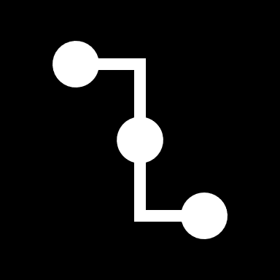
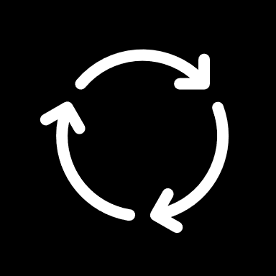
Core Idea
Markov Chain Monte Carlo (MCMC)
The process follows a Markovian framework for progressive noise addition and removal.
Notes:
Key Point: The core idea is to gradually add noise to data, then train a model to remove the noise step-by-step – learning to generate new data by reversing the noising process.
Detailed Explanation: Describe the fundamental process in intuitive terms. Imagine you have a clean image. The forward diffusion process involves adding a tiny amount of noise to it, getting a slightly noisier image. Then add a bit more noise, and so on. After many small steps, the image becomes essentially random noise (you can’t see any original content). Now, the reverse process is what the neural network learns: it starts with a noisy image and tries to predict a less-noisy image. In training, the model is given an image at some intermediate noise level and learns to denoise it by predicting the structure (or equivalently, the noise to remove). By training across all levels of noise, the model learns how to go from pure noise all the way back to a clean image. Emphasize that this is done gradually: instead of trying to generate an image in one shot, the model solves a sequence of easier problems (denoise a little bit). After training, to generate a new sample, we can begin with random noise and apply the model repeatedly to recover a data sample (e.g., an image) – essentially tracing the path back from noise to data. For a beginner-friendly analogy, compare this to sculpting: you start with a random block (noise) and the model carves it step by step into a final sculpture (the output image), removing a little excess material (noise) at each step. This iterative refinement is powerful because each step is small and tractable. For more advanced listeners, you can mention that mathematically this is akin to learning the score function (gradient of the data density) at various noise levels – the model is learning how the data distribution looks in the presence of noise, which connects to techniques like score matching. But the main takeaway: diffusion models generate data by learning to undo a gradual noising process, which is a very different approach from, say, GANs that generate data in one pass. This approach leads to very high-quality results because of the fine-grained control the model has at each step.

Slide 8
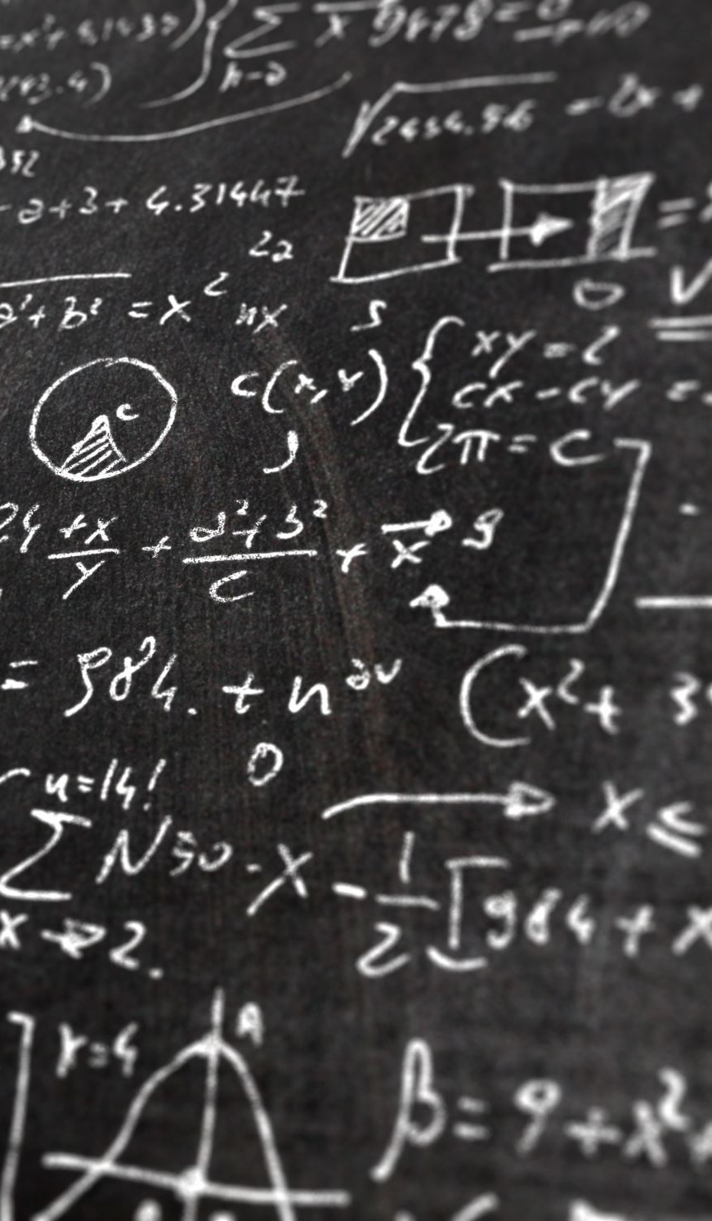

Mathematical Formulation
Forward Process
Defined by a Markovian process where data $x_{0}$is gradually corrupted:
$q\left(x_{t} ∣ x_{\left\{t−1\right\}}\right)= \left(N(x_{t}; \sqrt{\left\{1 − β_{t}\right\},}x_{\left\{t−1\right\}}, β_{t}I)\right)$
Notes:
Below is a text-friendly explanation, with the key mathematical details written in plain text so you can see exactly how it all works.
1) The Forward (Noise-Adding) Process
Goal: Gradually turn a real data sample into noise by applying a series of small steps.
Starting point: A data sample x_0 drawn from the real data distribution q(x_0).
Markov chain: We define x_1, x_2, ..., x_T through a sequence of conditional probabilities, each step only depending on the previous one.
Typical formulation (Gaussian noise): For each t in {1, 2, ..., T}:
q(x_t | x_{t-1}) = Normal( mean = sqrt(1 - beta_t) * x_{t-1}, covariance = beta_t * I ) Here:
beta_t is a small positive number (noise level) at step t.
I is the identity matrix, which just says we're adding isotropic (same in all directions) Gaussian noise.
In many papers, you’ll see this expressed as:
x_t = sqrt(1 - beta_t) * x_{t-1} + sqrt(beta_t) * z where z is drawn from a Normal(0, I) distribution (pure randomness).
What happens as t increases?
With each step, we add a bit more noise.
After T steps, x_T is almost completely random noise.
2) The Reverse (Denoising) Process
Goal: Learn how to reverse the noise-adding steps, moving from pure noise (x_T) back to something like the original data (x_0).
We define a model p_theta(x_{t-1} | x_t) (the “reverse” transition) with parameters theta.
It is also a Markov chain: each x_{t-1} depends only on x_t and not on earlier steps.
Typical parametrization (again, Gaussian):
p_theta(x_{t-1} | x_t) = Normal( mean = mu_theta(x_t, t), covariance = Sigma_theta(x_t, t) ) mu_theta(x_t, t) and Sigma_theta(x_t, t) are predicted by a neural network, which takes in the current noisy sample x_t and the step index t.
In many implementations, Sigma_theta is fixed or simplified, and the network mainly predicts the mean.
3) The Generative Chain
When we generate new samples, we:
Start with x_T ~ Normal(0, I) (pure noise).
Iteratively apply: x_{t-1} ~ p_theta(x_{t-1} | x_t) until we reach x_0, which should look like realistic data.
So the overall generative model is:
p_theta(x_{0:T}) = p(x_T) * (product over t=1..T of p_theta(x_{t-1} | x_t)) where p(x_T) = Normal(0, I).
4) Why This Is Probabilistically Grounded
We have a forward process q(x_{0:T}) that describes how real data becomes noise.
We have a reverse process p_theta(x_{0:T}) that’s meant to reverse it.
We train the reverse process (the neural network parameters theta) to match the true reverse of q as closely as possible.
Because both directions form Markov chains, it’s easier to define a loss function and optimize parameters using standard techniques like variational inference.
In plain language:
We corrupt our real data a little bit at a time until it’s basically just random noise.
We train a neural network to reverse this corruption.
Then, to generate new samples, we start from random noise and let the reverse process reconstruct something that looks like real data.
This combination of a forward chain and a reverse chain is what makes diffusion models both elegant and effective.

Slide 9

Mathematical Formulation
Reverse Process
Model learns $p\left(x_{\left\{t−1\right\}}\right|x_{t})$to reconstruct data, often parameterized as a neural network predicting added noise.
Notes:
Below is a text-friendly explanation, with the key mathematical details written in plain text so you can see exactly how it all works.
1) The Forward (Noise-Adding) Process
Goal: Gradually turn a real data sample into noise by applying a series of small steps.
Starting point: A data sample x_0 drawn from the real data distribution q(x_0).
Markov chain: We define x_1, x_2, ..., x_T through a sequence of conditional probabilities, each step only depending on the previous one.
Typical formulation (Gaussian noise): For each t in {1, 2, ..., T}:
q(x_t | x_{t-1}) = Normal( mean = sqrt(1 - beta_t) * x_{t-1}, covariance = beta_t * I ) Here:
beta_t is a small positive number (noise level) at step t.
I is the identity matrix, which just says we're adding isotropic (same in all directions) Gaussian noise.
In many papers, you’ll see this expressed as:
x_t = sqrt(1 - beta_t) * x_{t-1} + sqrt(beta_t) * z where z is drawn from a Normal(0, I) distribution (pure randomness).
What happens as t increases?
With each step, we add a bit more noise.
After T steps, x_T is almost completely random noise.
2) The Reverse (Denoising) Process
Goal: Learn how to reverse the noise-adding steps, moving from pure noise (x_T) back to something like the original data (x_0).
We define a model p_theta(x_{t-1} | x_t) (the “reverse” transition) with parameters theta.
It is also a Markov chain: each x_{t-1} depends only on x_t and not on earlier steps.
Typical parametrization (again, Gaussian):
p_theta(x_{t-1} | x_t) = Normal( mean = mu_theta(x_t, t), covariance = Sigma_theta(x_t, t) ) mu_theta(x_t, t) and Sigma_theta(x_t, t) are predicted by a neural network, which takes in the current noisy sample x_t and the step index t.
In many implementations, Sigma_theta is fixed or simplified, and the network mainly predicts the mean.
3) The Generative Chain
When we generate new samples, we:
Start with x_T ~ Normal(0, I) (pure noise).
Iteratively apply: x_{t-1} ~ p_theta(x_{t-1} | x_t) until we reach x_0, which should look like realistic data.
So the overall generative model is:
p_theta(x_{0:T}) = p(x_T) * (product over t=1..T of p_theta(x_{t-1} | x_t)) where p(x_T) = Normal(0, I).
4) Why This Is Probabilistically Grounded
We have a forward process q(x_{0:T}) that describes how real data becomes noise.
We have a reverse process p_theta(x_{0:T}) that’s meant to reverse it.
We train the reverse process (the neural network parameters theta) to match the true reverse of q as closely as possible.
Because both directions form Markov chains, it’s easier to define a loss function and optimize parameters using standard techniques like variational inference.
In plain language:
We corrupt our real data a little bit at a time until it’s basically just random noise.
We train a neural network to reverse this corruption.
Then, to generate new samples, we start from random noise and let the reverse process reconstruct something that looks like real data.
This combination of a forward chain and a reverse chain is what makes diffusion models both elegant and effective.

Slide 10
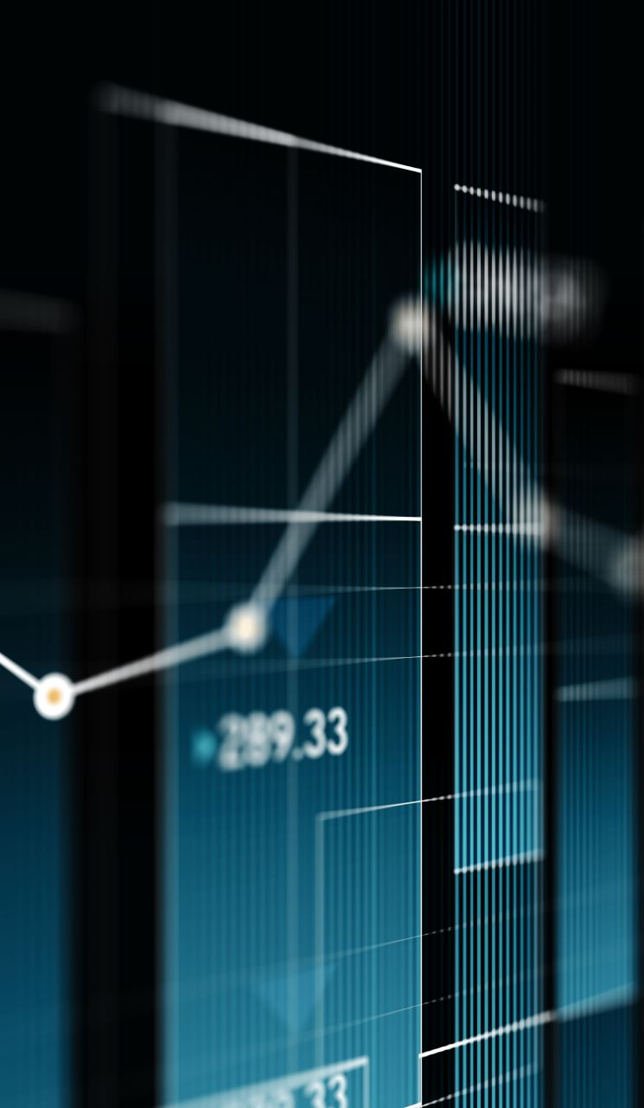
Training Objective
Variational Lower Bound (ELBO)
Optimization involves minimizing KL divergence between real and generated distributions.
Notes:
Key Point: We train the model by maximizing a variational lower bound (ELBO) on the data likelihood (which is equivalent to minimizing a KL divergence), but in practice this training can be done using a simplified loss – teaching the model to predict the added noise using a mean squared error (MSE) criterion.
Detailed Explanation: Explain that since we have a probabilistic model $p_\theta(x_{0:T})$ and a known forward process $q(x_{0:T})$, we can derive a training objective from probabilistic principles. The most direct way is to maximize the likelihood of the data under our model $p_\theta(x_0)$ (i.e., make the model generate data like the training set). This is hard to do directly because of the many latent variables ($x_1, \dots, x_T$). Instead, we derive an Evidence Lower Bound (ELBO), which is a standard approach in variational inference. Without going too deep into derivations, mention that the ELBO comes from Jensen’s inequality and provides a tractable surrogate for log-likelihood. Maximizing the ELBO corresponds to minimizing the KL divergence between the model’s joint distribution and the true forward joint distribution of the data and noise​file-coftxcup6pc4h4qvh8dcw3
. In practical terms, the ELBO for diffusion models breaks down into a sum of expected losses at each timestep $t$, comparing the model’s predicted $p_\theta(x_{t-1}|x_t)$ to the true $q(x_{t-1}|x_t)$ (which is known from the forward process). This yields a sequence of loss terms, and when summed up, that is the objective the model is trained on. This was how diffusion models were originally trained (and it’s very principled).
However, an important discovery was that you could simplify the loss dramatically without sacrificing performance. Ho et al. (2020), the authors of the Denoising Diffusion Probabilistic Models paper, showed that instead of directly computing all those KL terms, you could train the model to predict the noise added at step $t$. Here’s how: during training, take a real data example $x_0$, choose a random timestep $t$, and simulate the forward process to get a noisy sample $x_t$. Because we know the forward process, we can sample $x_t$ in one go (there are closed-form formulas for $q(x_t|x_0)$). Along with $x_t$, we also know exactly the noise $\epsilon$ that was added to get $x_t$ from $x_0$. Now feed $x_t$ (and $t$) into the neural network. Instead of predicting $x_{t-1}$ directly, have the network output $\hat{\epsilon}\theta$ – its estimate of the noise. Then compute the loss as the mean squared error between the predicted noise and the true noise: $L = \mathbb{E}|\epsilon - \hat{\epsilon}\theta(x_t, t)|^2$. This simple MSE loss turns out to be equivalent to a weighted form of the ELBO loss (it places different weights on the timestep terms, but it empirically works well and simplifies implementation). Optimizing this loss trains the model to denoise – because if you can predict the noise, you can subtract it out to get a cleaner image. This approach is often called denoising score matching in retrospect, as it relates to score-based models. The key benefit is that it’s easy to implement and very stable: the model just tries to output a residual (noise) given a noisy input.
Conclude this slide by reinforcing: from a high-level we are still doing maximum likelihood (via the ELBO)​file-coftxcup6pc4h4qvh8dcw3
, which appeals to the probabilistic purists, but from a practical standpoint we train by simply making the model predict noise in a mean-squared sense. This gives us the best of both worlds – a principled foundation and a clean practical loss function.

Slide 11
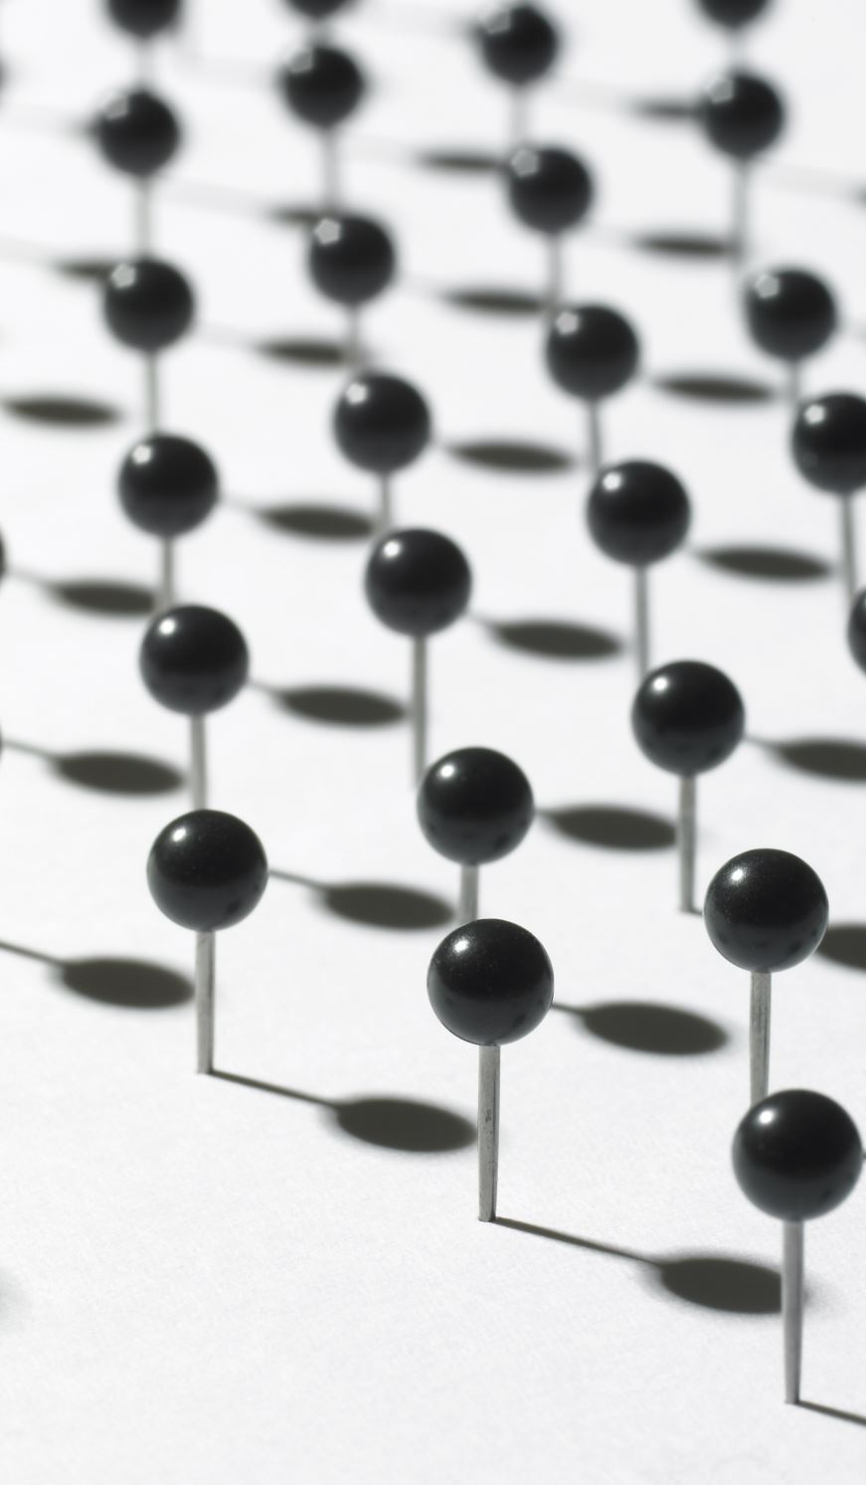
Training Objective
Simplified Loss Function
Common approach is training the model to predict added noise using mean squared error (MSE).
Notes:
Key Point: We train the model by maximizing a variational lower bound (ELBO) on the data likelihood (which is equivalent to minimizing a KL divergence), but in practice this training can be done using a simplified loss – teaching the model to predict the added noise using a mean squared error (MSE) criterion.
Detailed Explanation: Explain that since we have a probabilistic model $p_\theta(x_{0:T})$ and a known forward process $q(x_{0:T})$, we can derive a training objective from probabilistic principles. The most direct way is to maximize the likelihood of the data under our model $p_\theta(x_0)$ (i.e., make the model generate data like the training set). This is hard to do directly because of the many latent variables ($x_1, \dots, x_T$). Instead, we derive an Evidence Lower Bound (ELBO), which is a standard approach in variational inference. Without going too deep into derivations, mention that the ELBO comes from Jensen’s inequality and provides a tractable surrogate for log-likelihood. Maximizing the ELBO corresponds to minimizing the KL divergence between the model’s joint distribution and the true forward joint distribution of the data and noise​file-coftxcup6pc4h4qvh8dcw3
. In practical terms, the ELBO for diffusion models breaks down into a sum of expected losses at each timestep $t$, comparing the model’s predicted $p_\theta(x_{t-1}|x_t)$ to the true $q(x_{t-1}|x_t)$ (which is known from the forward process). This yields a sequence of loss terms, and when summed up, that is the objective the model is trained on. This was how diffusion models were originally trained (and it’s very principled).
However, an important discovery was that you could simplify the loss dramatically without sacrificing performance. Ho et al. (2020), the authors of the Denoising Diffusion Probabilistic Models paper, showed that instead of directly computing all those KL terms, you could train the model to predict the noise added at step $t$. Here’s how: during training, take a real data example $x_0$, choose a random timestep $t$, and simulate the forward process to get a noisy sample $x_t$. Because we know the forward process, we can sample $x_t$ in one go (there are closed-form formulas for $q(x_t|x_0)$). Along with $x_t$, we also know exactly the noise $\epsilon$ that was added to get $x_t$ from $x_0$. Now feed $x_t$ (and $t$) into the neural network. Instead of predicting $x_{t-1}$ directly, have the network output $\hat{\epsilon}\theta$ – its estimate of the noise. Then compute the loss as the mean squared error between the predicted noise and the true noise: $L = \mathbb{E}|\epsilon - \hat{\epsilon}\theta(x_t, t)|^2$. This simple MSE loss turns out to be equivalent to a weighted form of the ELBO loss (it places different weights on the timestep terms, but it empirically works well and simplifies implementation). Optimizing this loss trains the model to denoise – because if you can predict the noise, you can subtract it out to get a cleaner image. This approach is often called denoising score matching in retrospect, as it relates to score-based models. The key benefit is that it’s easy to implement and very stable: the model just tries to output a residual (noise) given a noisy input.
Conclude this slide by reinforcing: from a high-level we are still doing maximum likelihood (via the ELBO)​file-coftxcup6pc4h4qvh8dcw3
, which appeals to the probabilistic purists, but from a practical standpoint we train by simply making the model predict noise in a mean-squared sense. This gives us the best of both worlds – a principled foundation and a clean practical loss function.

Slide 12
Sampling from a Diffusion Model
Step-by-step Sampling
1. Start with Gaussian noise
2. Iteratively denoise using learned
3. After T steps, obtain a sample resembling real data.
Notes:
Key Point: To generate a sample, we start with random noise and iteratively denoise it using the learned model for $T$ steps until we obtain a data sample. Techniques like DDIM can accelerate this sampling by using fewer steps than the original $T$.
Detailed Explanation: Now that the model is trained, explain how to generate new data (sampling). This is essentially running the learned reverse process. The procedure is:
Initialization (Step $T$): Begin with a random noise sample $x_T \sim \mathcal{N}(0, I)$. For example, if we trained on 64×64 images, $x_T$ would be a 64×64 image of pure noise. This $x_T$ is analogous to the endpoint of the forward process (complete noise).
Iterative Denoising: For $t = T, T-1, \dots, 1$, do: feed $x_t$ into our model (along with the timestep $t$ as a condition). The model will output a prediction of the noise $\hat{\epsilon}\theta$. From that, we compute $x{t-1}$. How exactly? One simple way is: $\hat{x}{t-1} = \frac{1}{\sqrt{1-\beta_t}},(x_t - \sqrt{\beta_t},\hat{\epsilon}\theta)$, which comes from rearranging the forward equation. In practice, implementations may sample from a Gaussian using the model’s predicted mean and add some randomness for stochasticity. But conceptually, the model tells us how to go backwards one step. We then obtain a slightly less noisy image $x_{t-1}`. Next, use $x_{t-1}$ as input and repeat the process for step $t-1$.
Termination: After we perform this for $t=1$, we get $x_0$. This $x_0$ is our generated data sample (e.g., a fully denoised image). If the model has learned well, $x_0$ should look like it came from the training data distribution (say, a realistic image of a cat, if the model was trained on cat photos).
This process is slow if $T$ is large (imagine 1000 iterations to get one sample). Highlight that one main drawback of vanilla diffusion models is this lengthy sampling. However, researchers have developed methods to speed it up. One notable method mentioned is DDIM (Denoising Diffusion Implicit Models). Explain that DDIM is a different way to use the diffusion model that can drastically reduce the number of steps needed. It finds a non-Markovian but deterministic path through the diffusion process that allows you to jump larger intervals. For instance, instead of 1000 tiny denoising steps, you could do 100 somewhat larger steps and still get a good result. The model is the same – it’s how you use it that changes. DDIM can produce similar quality samples in, say, 50 steps that a naive algorithm might take 1000 steps for​slazebni.cs.illinois.edu
. You can mention other techniques (like predictor-corrector methods from score-based models, or newer samplers) to show this is an active area. The key idea is that we trade off some of the gradualness for speed in a smart way.
To keep it engaging, you might describe what it looks like if you visualize the sampling: you start with pure snow-like noise, then slowly forms and shapes appear as the steps go on, and by the final step you have a clear image – it’s like watching an image come into focus over time. Summarize that sampling is an iterative refinement process, and while inherently slower than one-shot generation, methods like DDIM have made it much faster than it initially was​file-coftxcup6pc4h4qvh8dcw3
. This is crucial for making diffusion models practical.

Slide 13
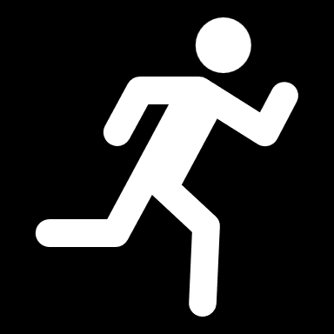
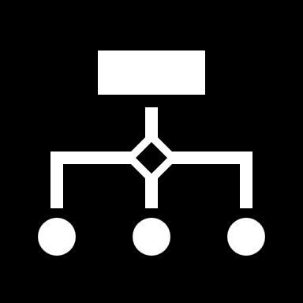
Sampling from a Diffusion Model
Sampling Acceleration
Methods like DDIM (Denoising Diffusion Implicit Models) reduce the number of required steps.
Notes:
Key Point: To generate a sample, we start with random noise and iteratively denoise it using the learned model for $T$ steps until we obtain a data sample. Techniques like DDIM can accelerate this sampling by using fewer steps than the original $T$.
Detailed Explanation: Now that the model is trained, explain how to generate new data (sampling). This is essentially running the learned reverse process. The procedure is:
Initialization (Step $T$): Begin with a random noise sample $x_T \sim \mathcal{N}(0, I)$. For example, if we trained on 64×64 images, $x_T$ would be a 64×64 image of pure noise. This $x_T$ is analogous to the endpoint of the forward process (complete noise).
Iterative Denoising: For $t = T, T-1, \dots, 1$, do: feed $x_t$ into our model (along with the timestep $t$ as a condition). The model will output a prediction of the noise $\hat{\epsilon}\theta$. From that, we compute $x{t-1}$. How exactly? One simple way is: $\hat{x}{t-1} = \frac{1}{\sqrt{1-\beta_t}},(x_t - \sqrt{\beta_t},\hat{\epsilon}\theta)$, which comes from rearranging the forward equation. In practice, implementations may sample from a Gaussian using the model’s predicted mean and add some randomness for stochasticity. But conceptually, the model tells us how to go backwards one step. We then obtain a slightly less noisy image $x_{t-1}`. Next, use $x_{t-1}$ as input and repeat the process for step $t-1$.
Termination: After we perform this for $t=1$, we get $x_0$. This $x_0$ is our generated data sample (e.g., a fully denoised image). If the model has learned well, $x_0$ should look like it came from the training data distribution (say, a realistic image of a cat, if the model was trained on cat photos).
This process is slow if $T$ is large (imagine 1000 iterations to get one sample). Highlight that one main drawback of vanilla diffusion models is this lengthy sampling. However, researchers have developed methods to speed it up. One notable method mentioned is DDIM (Denoising Diffusion Implicit Models). Explain that DDIM is a different way to use the diffusion model that can drastically reduce the number of steps needed. It finds a non-Markovian but deterministic path through the diffusion process that allows you to jump larger intervals. For instance, instead of 1000 tiny denoising steps, you could do 100 somewhat larger steps and still get a good result. The model is the same – it’s how you use it that changes. DDIM can produce similar quality samples in, say, 50 steps that a naive algorithm might take 1000 steps for​slazebni.cs.illinois.edu
. You can mention other techniques (like predictor-corrector methods from score-based models, or newer samplers) to show this is an active area. The key idea is that we trade off some of the gradualness for speed in a smart way.
To keep it engaging, you might describe what it looks like if you visualize the sampling: you start with pure snow-like noise, then slowly forms and shapes appear as the steps go on, and by the final step you have a clear image – it’s like watching an image come into focus over time. Summarize that sampling is an iterative refinement process, and while inherently slower than one-shot generation, methods like DDIM have made it much faster than it initially was​file-coftxcup6pc4h4qvh8dcw3
. This is crucial for making diffusion models practical.

Slide 14


Architectural Choices
UNet-based Models
Most diffusion models use UNet architectures for effective denoising.
Notes:
Key Point: Diffusion models typically use a U-Net architecture as the denoising model (to leverage multi-scale features with skip connections), they include time-step embeddings (a form of positional encoding) to inform the network of the current diffusion step, and they often use classifier-free guidance for conditional generation without needing a separate classifier.
Detailed Explanation: Break down the major architectural components that make diffusion models work well:
U-Net Backbone: Start by explaining why a U-Net is used. A U-Net is an encoder–decoder network with skip connections between corresponding layers of the encoder and decoder. In our context, the input to the U-Net is a noisy image (at step $t$) and the output is the denoised result (often the predicted noise or $x_{t-1}$). The encoder gradually downsamples the image, extracting coarse features (context, overall structure). The decoder then upsamples it back to the original resolution, generating fine details. The skip connections funnel high-resolution details from the encoder straight into the decoder, so that the fine details lost in downsampling can be re-introduced. This architecture is effective for denoising tasks because it captures both global context and local detail. Most diffusion models, including DDPMs and Stable Diffusion, rely on a U-Net or a variant of it​logessiva.medium.com
. This is mentioned in the slide: “UNet-based Models – Most diffusion models use UNet architectures for effective denoising.” You can add that the U-Net has been a workhorse in many image restoration tasks (e.g., it’s used in biomedical segmentation, super-resolution, etc.), so it was a natural choice for diffusion. For the audience: if they’re beginners, just emphasize it’s a type of neural network particularly good for image-to-image tasks; if they’re intermediate, maybe sketch or describe the encoder-decoder structure; for experts, note that newer designs add attention layers or other tweaks, but the U-Net core remains common.
Time-Step (Positional) Embeddings: Next, address how the model knows which diffusion step it’s handling. This is crucial because the denoising needed for early steps (lots of noise) is very different from later steps (little noise). The solution is to provide the time index $t$ as an input to the network via an embedding. Typically, we convert the scalar $t$ into a high-dimensional vector – often using a sinusoidal positional encoding (like those used in Transformers) or a learned embedding. This time embedding is then injected into the U-Net, for example by adding it into the feature maps or through specialized layers at each stage. The slide calls these Positional Embeddings, which improve performance especially for high-resolution data. Clarify that here "positional" refers to the diffusion timestep (not spatial position) – essentially treating the timestep as a position along a sequence and embedding it. Providing this information is like telling the model “this image is very noisy (early in diffusion)” or “this image is almost clean (later stage)”. Without it, the U-Net would have no context of how much to denoise. For high-resolution image diffusion, sometimes additional spatial coordinate embeddings are used too (so the model is aware of pixel positions – helping with very large images where purely convolutional U-Nets might struggle with spatial information). But the main point: embedding the diffusion time step is critical. This allows the same network to handle all levels of noise dynamically. In summary, the network gets two inputs: the noisy data and an encoding of $t$ that situates the network in the diffusion process.
Classifier-Free Guidance: Finally, explain the concept of guidance for conditional diffusion models. In many applications, we want to control what the diffusion model generates (e.g., generate an image of a cat vs a dog, or follow a text prompt). The slide mentions classifier-free guidance, which is a popular technique introduced by Ho & Salimans (2021). The idea is to train the diffusion U-Net itself to handle both conditioned and unconditioned generation, then at sampling time combine these to guide the output. Concretely, during training, you sometimes feed the conditioning (say, a class label or text embedding) into the U-Net along with the noisy image, and other times you blank out the condition (feeding a null token) – essentially training the model to work with or without the condition. At generation, you do two forward passes: one with the condition and one without, and then interpolate between these predictions (extrapolating towards the conditional one). By doing this, you effectively push the sample closer to what the condition asks for. For example, if the condition is “cat”, the conditional pass will try to add features of a cat, the unconditional pass just denoises generally; by mixing them with a certain weight, you can strengthen the cat features. This achieves a similar effect to the earlier classifier-guided diffusion (where an external classifier was used to adjust the gradients) but without needing a separate classifier model – hence “classifier-free.” This method has become the standard in guided image synthesis because it’s simple and works extremely well to improve fidelity to the prompt without collapsing diversity. Mention that Stable Diffusion and Imagen use classifier-free guidance to handle text prompts. For the audience, you could say: essentially, we train the model to both “do its own thing” and “follow a guide,” and then combine those behaviors to get better results. The take-home: modern diffusion architectures are not just a plain U-Net; they are augmented with time embeddings and often trained in a way to enable guided generation. These choices have been crucial for the high quality and controllability we see in diffusion model outputs.

Slide 15
Architectural Choices
Positional Embeddings
Improve performance, especially for high-resolution data.
Notes:
Key Point: Diffusion models typically use a U-Net architecture as the denoising model (to leverage multi-scale features with skip connections), they include time-step embeddings (a form of positional encoding) to inform the network of the current diffusion step, and they often use classifier-free guidance for conditional generation without needing a separate classifier.
Detailed Explanation: Break down the major architectural components that make diffusion models work well:
U-Net Backbone: Start by explaining why a U-Net is used. A U-Net is an encoder–decoder network with skip connections between corresponding layers of the encoder and decoder. In our context, the input to the U-Net is a noisy image (at step $t$) and the output is the denoised result (often the predicted noise or $x_{t-1}$). The encoder gradually downsamples the image, extracting coarse features (context, overall structure). The decoder then upsamples it back to the original resolution, generating fine details. The skip connections funnel high-resolution details from the encoder straight into the decoder, so that the fine details lost in downsampling can be re-introduced. This architecture is effective for denoising tasks because it captures both global context and local detail. Most diffusion models, including DDPMs and Stable Diffusion, rely on a U-Net or a variant of it​logessiva.medium.com
. This is mentioned in the slide: “UNet-based Models – Most diffusion models use UNet architectures for effective denoising.” You can add that the U-Net has been a workhorse in many image restoration tasks (e.g., it’s used in biomedical segmentation, super-resolution, etc.), so it was a natural choice for diffusion. For the audience: if they’re beginners, just emphasize it’s a type of neural network particularly good for image-to-image tasks; if they’re intermediate, maybe sketch or describe the encoder-decoder structure; for experts, note that newer designs add attention layers or other tweaks, but the U-Net core remains common.
Time-Step (Positional) Embeddings: Next, address how the model knows which diffusion step it’s handling. This is crucial because the denoising needed for early steps (lots of noise) is very different from later steps (little noise). The solution is to provide the time index $t$ as an input to the network via an embedding. Typically, we convert the scalar $t$ into a high-dimensional vector – often using a sinusoidal positional encoding (like those used in Transformers) or a learned embedding. This time embedding is then injected into the U-Net, for example by adding it into the feature maps or through specialized layers at each stage. The slide calls these Positional Embeddings, which improve performance especially for high-resolution data. Clarify that here "positional" refers to the diffusion timestep (not spatial position) – essentially treating the timestep as a position along a sequence and embedding it. Providing this information is like telling the model “this image is very noisy (early in diffusion)” or “this image is almost clean (later stage)”. Without it, the U-Net would have no context of how much to denoise. For high-resolution image diffusion, sometimes additional spatial coordinate embeddings are used too (so the model is aware of pixel positions – helping with very large images where purely convolutional U-Nets might struggle with spatial information). But the main point: embedding the diffusion time step is critical. This allows the same network to handle all levels of noise dynamically. In summary, the network gets two inputs: the noisy data and an encoding of $t$ that situates the network in the diffusion process.
Classifier-Free Guidance: Finally, explain the concept of guidance for conditional diffusion models. In many applications, we want to control what the diffusion model generates (e.g., generate an image of a cat vs a dog, or follow a text prompt). The slide mentions classifier-free guidance, which is a popular technique introduced by Ho & Salimans (2021). The idea is to train the diffusion U-Net itself to handle both conditioned and unconditioned generation, then at sampling time combine these to guide the output. Concretely, during training, you sometimes feed the conditioning (say, a class label or text embedding) into the U-Net along with the noisy image, and other times you blank out the condition (feeding a null token) – essentially training the model to work with or without the condition. At generation, you do two forward passes: one with the condition and one without, and then interpolate between these predictions (extrapolating towards the conditional one). By doing this, you effectively push the sample closer to what the condition asks for. For example, if the condition is “cat”, the conditional pass will try to add features of a cat, the unconditional pass just denoises generally; by mixing them with a certain weight, you can strengthen the cat features. This achieves a similar effect to the earlier classifier-guided diffusion (where an external classifier was used to adjust the gradients) but without needing a separate classifier model – hence “classifier-free.” This method has become the standard in guided image synthesis because it’s simple and works extremely well to improve fidelity to the prompt without collapsing diversity. Mention that Stable Diffusion and Imagen use classifier-free guidance to handle text prompts. For the audience, you could say: essentially, we train the model to both “do its own thing” and “follow a guide,” and then combine those behaviors to get better results. The take-home: modern diffusion architectures are not just a plain U-Net; they are augmented with time embeddings and often trained in a way to enable guided generation. These choices have been crucial for the high quality and controllability we see in diffusion model outputs.

Slide 16
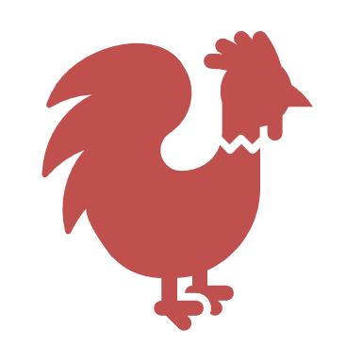

Architectural Choices
Classifier-free Guidance
Allows conditional generation without requiring an explicit classifier.
Notes:
Key Point: Diffusion models typically use a U-Net architecture as the denoising model (to leverage multi-scale features with skip connections), they include time-step embeddings (a form of positional encoding) to inform the network of the current diffusion step, and they often use classifier-free guidance for conditional generation without needing a separate classifier.
Detailed Explanation: Break down the major architectural components that make diffusion models work well:
U-Net Backbone: Start by explaining why a U-Net is used. A U-Net is an encoder–decoder network with skip connections between corresponding layers of the encoder and decoder. In our context, the input to the U-Net is a noisy image (at step $t$) and the output is the denoised result (often the predicted noise or $x_{t-1}$). The encoder gradually downsamples the image, extracting coarse features (context, overall structure). The decoder then upsamples it back to the original resolution, generating fine details. The skip connections funnel high-resolution details from the encoder straight into the decoder, so that the fine details lost in downsampling can be re-introduced. This architecture is effective for denoising tasks because it captures both global context and local detail. Most diffusion models, including DDPMs and Stable Diffusion, rely on a U-Net or a variant of it​logessiva.medium.com
. This is mentioned in the slide: “UNet-based Models – Most diffusion models use UNet architectures for effective denoising.” You can add that the U-Net has been a workhorse in many image restoration tasks (e.g., it’s used in biomedical segmentation, super-resolution, etc.), so it was a natural choice for diffusion. For the audience: if they’re beginners, just emphasize it’s a type of neural network particularly good for image-to-image tasks; if they’re intermediate, maybe sketch or describe the encoder-decoder structure; for experts, note that newer designs add attention layers or other tweaks, but the U-Net core remains common.
Time-Step (Positional) Embeddings: Next, address how the model knows which diffusion step it’s handling. This is crucial because the denoising needed for early steps (lots of noise) is very different from later steps (little noise). The solution is to provide the time index $t$ as an input to the network via an embedding. Typically, we convert the scalar $t$ into a high-dimensional vector – often using a sinusoidal positional encoding (like those used in Transformers) or a learned embedding. This time embedding is then injected into the U-Net, for example by adding it into the feature maps or through specialized layers at each stage. The slide calls these Positional Embeddings, which improve performance especially for high-resolution data. Clarify that here "positional" refers to the diffusion timestep (not spatial position) – essentially treating the timestep as a position along a sequence and embedding it. Providing this information is like telling the model “this image is very noisy (early in diffusion)” or “this image is almost clean (later stage)”. Without it, the U-Net would have no context of how much to denoise. For high-resolution image diffusion, sometimes additional spatial coordinate embeddings are used too (so the model is aware of pixel positions – helping with very large images where purely convolutional U-Nets might struggle with spatial information). But the main point: embedding the diffusion time step is critical. This allows the same network to handle all levels of noise dynamically. In summary, the network gets two inputs: the noisy data and an encoding of $t$ that situates the network in the diffusion process.
Classifier-Free Guidance: Finally, explain the concept of guidance for conditional diffusion models. In many applications, we want to control what the diffusion model generates (e.g., generate an image of a cat vs a dog, or follow a text prompt). The slide mentions classifier-free guidance, which is a popular technique introduced by Ho & Salimans (2021). The idea is to train the diffusion U-Net itself to handle both conditioned and unconditioned generation, then at sampling time combine these to guide the output. Concretely, during training, you sometimes feed the conditioning (say, a class label or text embedding) into the U-Net along with the noisy image, and other times you blank out the condition (feeding a null token) – essentially training the model to work with or without the condition. At generation, you do two forward passes: one with the condition and one without, and then interpolate between these predictions (extrapolating towards the conditional one). By doing this, you effectively push the sample closer to what the condition asks for. For example, if the condition is “cat”, the conditional pass will try to add features of a cat, the unconditional pass just denoises generally; by mixing them with a certain weight, you can strengthen the cat features. This achieves a similar effect to the earlier classifier-guided diffusion (where an external classifier was used to adjust the gradients) but without needing a separate classifier model – hence “classifier-free.” This method has become the standard in guided image synthesis because it’s simple and works extremely well to improve fidelity to the prompt without collapsing diversity. Mention that Stable Diffusion and Imagen use classifier-free guidance to handle text prompts. For the audience, you could say: essentially, we train the model to both “do its own thing” and “follow a guide,” and then combine those behaviors to get better results. The take-home: modern diffusion architectures are not just a plain U-Net; they are augmented with time embeddings and often trained in a way to enable guided generation. These choices have been crucial for the high quality and controllability we see in diffusion model outputs.

Slide 17


Key Advancements
Latent Diffusion Models (LDMs)
Reduces computational cost by applying diffusion in a compressed latent space.
Notes:
Key Point: Recent advancements have improved diffusion models in various ways: Latent Diffusion Models (LDMs) make them more efficient by operating in compressed spaces, Score-Based Generative Models (SGM) provide a continuous-time perspective with score matching that improved training and sampling, and Guided Diffusion techniques (including classifier guidance and classifier-free guidance) allow controllable generation of outputs like images or text.
Detailed Explanation: Go through each of the listed advancements, explaining their significance:
Latent Diffusion Models (LDMs): The idea of latent diffusion is to reduce the computational cost of diffusion models by not working in the original data space (e.g. pixel space) directly. Instead, you first compress the data into a smaller latent representation using an autoencoder. For example, an image might be encoded into a feature map that is 4× smaller in height and width (and with fewer channels) – so a huge 256×256×3 image becomes a more manageable 32×32×4 tensor. Then you train the diffusion model on these latents. Since each latent is much smaller than the original image, the diffusion model’s U-Net can be smaller and the number of operations is drastically less. After sampling in latent space, you decode the latent back into an image using the decoder of the autoencoder. This approach, introduced by Rombach et al. (2022), “reduces computational cost by applying diffusion in a compressed latent space”​file-coftxcup6pc4h4qvh8dcw3
​arxiv.org
. Emphasize that this was a game-changer for scaling diffusion to high-resolution images and for making models like Stable Diffusion feasible on consumer hardware. LDMs maintain output quality because the autoencoder preserves important image details, but they save memory and time. Summarize: LDMs = diffusion on a smaller representation, which speeds up training and sampling without significantly hurting fidelity.
Score-Based Generative Modeling (SGM): This advancement actually grew in parallel with diffusion models. Score-based models (by Song & Ermon, 2019 and subsequent works) are based on the concept of score matching. They train a model to output the gradient of the log-density (score) of the data distribution at various noise levels. In practice, this looks very similar to what we described with diffusion: adding noise to data and training a network to denoise (which is effectively learning the score). The big twist in SGM was formulating the problem in continuous time. Song et al. introduced the notion of infinitely many noise steps, turning the discrete diffusion process into a continuous Stochastic Differential Equation (SDE). In this view, data is gradually perturbed by an SDE (like a continuous diffusion process), and the model learns to reverse it by solving the reverse-time SDE using the learned score function​ayandas.me
. This continuous formulation allowed using advanced numerical methods for sampling (like predictor-corrector or ODE solvers) and established a deep connection between diffusion models and differential equations. For the audience: the technical folks will appreciate that SGMs showed how you can integrate the diffusion process, leading to algorithms that sometimes sample faster or allow likelihood computation by integrating probability flow ODEs. Meanwhile, the practical outcome of SGM research was improvements in training stability and sampling flexibility. The terminology “score-based generative models” and “diffusion models” are often used interchangeably now, because it was shown they are mathematically equivalent in many cases (diffusion model training is basically denoising score matching). The slide’s point is that this line of work provided new techniques for training (score matching) and new insights (like connecting to SDEs and physics). It’s an advanced topic, but key for experts to know that diffusion models have a rich theory behind them – not just a hack.
Guided Diffusion: This refers to methods that improve or direct the generation process using guidance signals. We already covered classifier-free guidance on the architecture slide, so here you can mention the broader context. The first big guided diffusion was classifier-guided diffusion (Dhariwal & Nichol, 2021), where an external classifier is trained to predict (for example) the class of an image, and during diffusion sampling, one adjusts the model’s predictions using the gradients from this classifier to push the image towards a desired class. This demonstrated a dramatic improvement in class-conditional image generation quality – diffusion models, with guidance, surpassed GANs like BigGAN in FID score, etc. Following that, classifier-free guidance (discussed earlier) became popular for text-to-image models. The slide specifically says “Allows conditioning for controlled generation of images and text,” which encapsulates both these methods. Stress that guided diffusion enables controllability: we’re not stuck with just random samples, we can guide the process to follow prompts, class labels, or other conditions. For text-to-image, models like GLIDE, DALL·E 2, Imagen all use some form of guided diffusion – either implicitly through classifier-free techniques or explicitly with CLIP-based guidance. The result is the AI can create what you ask it to, not just random drawings. This is hugely important for real-world use because users want to specify what to generate. For the technical audience, you can note that guided diffusion introduced a trade-off parameter (guidance scale) that balances fidelity to the condition vs. diversity of samples, effectively allowing tuning of mode coverage vs quality​medium.com
. The advancement here is not a different model per se, but an enhancement that turns diffusion models from unguided generative models into powerful conditional generative models.
In summary, point out that these advancements address key aspects: efficiency (LDMs making diffusion faster and more feasible), theoretical depth (SGM connecting to continuous-time and providing new training methods), and controllability/quality (guidance boosting the quality and usefulness of outputs). Together, they have propelled diffusion models to the forefront of generative AI in a very short time.

Slide 18


Key Advancements
Score-based Generative Modeling (SGM)
Uses score-matching techniques for improved training.
Notes:
Key Point: Recent advancements have improved diffusion models in various ways: Latent Diffusion Models (LDMs) make them more efficient by operating in compressed spaces, Score-Based Generative Models (SGM) provide a continuous-time perspective with score matching that improved training and sampling, and Guided Diffusion techniques (including classifier guidance and classifier-free guidance) allow controllable generation of outputs like images or text.
Detailed Explanation: Go through each of the listed advancements, explaining their significance:
Latent Diffusion Models (LDMs): The idea of latent diffusion is to reduce the computational cost of diffusion models by not working in the original data space (e.g. pixel space) directly. Instead, you first compress the data into a smaller latent representation using an autoencoder. For example, an image might be encoded into a feature map that is 4× smaller in height and width (and with fewer channels) – so a huge 256×256×3 image becomes a more manageable 32×32×4 tensor. Then you train the diffusion model on these latents. Since each latent is much smaller than the original image, the diffusion model’s U-Net can be smaller and the number of operations is drastically less. After sampling in latent space, you decode the latent back into an image using the decoder of the autoencoder. This approach, introduced by Rombach et al. (2022), “reduces computational cost by applying diffusion in a compressed latent space”​file-coftxcup6pc4h4qvh8dcw3
​arxiv.org
. Emphasize that this was a game-changer for scaling diffusion to high-resolution images and for making models like Stable Diffusion feasible on consumer hardware. LDMs maintain output quality because the autoencoder preserves important image details, but they save memory and time. Summarize: LDMs = diffusion on a smaller representation, which speeds up training and sampling without significantly hurting fidelity.
Score-Based Generative Modeling (SGM): This advancement actually grew in parallel with diffusion models. Score-based models (by Song & Ermon, 2019 and subsequent works) are based on the concept of score matching. They train a model to output the gradient of the log-density (score) of the data distribution at various noise levels. In practice, this looks very similar to what we described with diffusion: adding noise to data and training a network to denoise (which is effectively learning the score). The big twist in SGM was formulating the problem in continuous time. Song et al. introduced the notion of infinitely many noise steps, turning the discrete diffusion process into a continuous Stochastic Differential Equation (SDE). In this view, data is gradually perturbed by an SDE (like a continuous diffusion process), and the model learns to reverse it by solving the reverse-time SDE using the learned score function​ayandas.me
. This continuous formulation allowed using advanced numerical methods for sampling (like predictor-corrector or ODE solvers) and established a deep connection between diffusion models and differential equations. For the audience: the technical folks will appreciate that SGMs showed how you can integrate the diffusion process, leading to algorithms that sometimes sample faster or allow likelihood computation by integrating probability flow ODEs. Meanwhile, the practical outcome of SGM research was improvements in training stability and sampling flexibility. The terminology “score-based generative models” and “diffusion models” are often used interchangeably now, because it was shown they are mathematically equivalent in many cases (diffusion model training is basically denoising score matching). The slide’s point is that this line of work provided new techniques for training (score matching) and new insights (like connecting to SDEs and physics). It’s an advanced topic, but key for experts to know that diffusion models have a rich theory behind them – not just a hack.
Guided Diffusion: This refers to methods that improve or direct the generation process using guidance signals. We already covered classifier-free guidance on the architecture slide, so here you can mention the broader context. The first big guided diffusion was classifier-guided diffusion (Dhariwal & Nichol, 2021), where an external classifier is trained to predict (for example) the class of an image, and during diffusion sampling, one adjusts the model’s predictions using the gradients from this classifier to push the image towards a desired class. This demonstrated a dramatic improvement in class-conditional image generation quality – diffusion models, with guidance, surpassed GANs like BigGAN in FID score, etc. Following that, classifier-free guidance (discussed earlier) became popular for text-to-image models. The slide specifically says “Allows conditioning for controlled generation of images and text,” which encapsulates both these methods. Stress that guided diffusion enables controllability: we’re not stuck with just random samples, we can guide the process to follow prompts, class labels, or other conditions. For text-to-image, models like GLIDE, DALL·E 2, Imagen all use some form of guided diffusion – either implicitly through classifier-free techniques or explicitly with CLIP-based guidance. The result is the AI can create what you ask it to, not just random drawings. This is hugely important for real-world use because users want to specify what to generate. For the technical audience, you can note that guided diffusion introduced a trade-off parameter (guidance scale) that balances fidelity to the condition vs. diversity of samples, effectively allowing tuning of mode coverage vs quality​medium.com
. The advancement here is not a different model per se, but an enhancement that turns diffusion models from unguided generative models into powerful conditional generative models.
In summary, point out that these advancements address key aspects: efficiency (LDMs making diffusion faster and more feasible), theoretical depth (SGM connecting to continuous-time and providing new training methods), and controllability/quality (guidance boosting the quality and usefulness of outputs). Together, they have propelled diffusion models to the forefront of generative AI in a very short time.

Slide 19
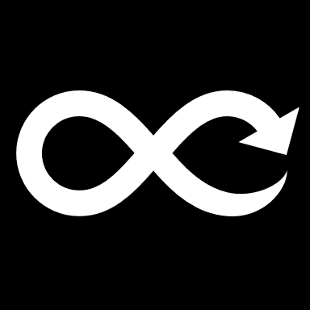
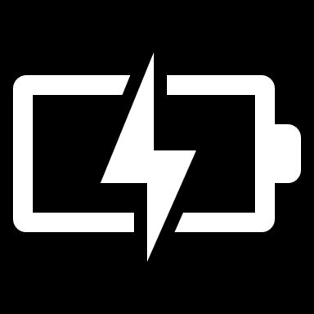
Key Advancements
Guided Diffusion
Allows conditioning for controlled generation of images and text.
Notes:
Key Point: Recent advancements have improved diffusion models in various ways: Latent Diffusion Models (LDMs) make them more efficient by operating in compressed spaces, Score-Based Generative Models (SGM) provide a continuous-time perspective with score matching that improved training and sampling, and Guided Diffusion techniques (including classifier guidance and classifier-free guidance) allow controllable generation of outputs like images or text.
Detailed Explanation: Go through each of the listed advancements, explaining their significance:
Latent Diffusion Models (LDMs): The idea of latent diffusion is to reduce the computational cost of diffusion models by not working in the original data space (e.g. pixel space) directly. Instead, you first compress the data into a smaller latent representation using an autoencoder. For example, an image might be encoded into a feature map that is 4× smaller in height and width (and with fewer channels) – so a huge 256×256×3 image becomes a more manageable 32×32×4 tensor. Then you train the diffusion model on these latents. Since each latent is much smaller than the original image, the diffusion model’s U-Net can be smaller and the number of operations is drastically less. After sampling in latent space, you decode the latent back into an image using the decoder of the autoencoder. This approach, introduced by Rombach et al. (2022), “reduces computational cost by applying diffusion in a compressed latent space”​file-coftxcup6pc4h4qvh8dcw3
​arxiv.org
. Emphasize that this was a game-changer for scaling diffusion to high-resolution images and for making models like Stable Diffusion feasible on consumer hardware. LDMs maintain output quality because the autoencoder preserves important image details, but they save memory and time. Summarize: LDMs = diffusion on a smaller representation, which speeds up training and sampling without significantly hurting fidelity.
Score-Based Generative Modeling (SGM): This advancement actually grew in parallel with diffusion models. Score-based models (by Song & Ermon, 2019 and subsequent works) are based on the concept of score matching. They train a model to output the gradient of the log-density (score) of the data distribution at various noise levels. In practice, this looks very similar to what we described with diffusion: adding noise to data and training a network to denoise (which is effectively learning the score). The big twist in SGM was formulating the problem in continuous time. Song et al. introduced the notion of infinitely many noise steps, turning the discrete diffusion process into a continuous Stochastic Differential Equation (SDE). In this view, data is gradually perturbed by an SDE (like a continuous diffusion process), and the model learns to reverse it by solving the reverse-time SDE using the learned score function​ayandas.me
. This continuous formulation allowed using advanced numerical methods for sampling (like predictor-corrector or ODE solvers) and established a deep connection between diffusion models and differential equations. For the audience: the technical folks will appreciate that SGMs showed how you can integrate the diffusion process, leading to algorithms that sometimes sample faster or allow likelihood computation by integrating probability flow ODEs. Meanwhile, the practical outcome of SGM research was improvements in training stability and sampling flexibility. The terminology “score-based generative models” and “diffusion models” are often used interchangeably now, because it was shown they are mathematically equivalent in many cases (diffusion model training is basically denoising score matching). The slide’s point is that this line of work provided new techniques for training (score matching) and new insights (like connecting to SDEs and physics). It’s an advanced topic, but key for experts to know that diffusion models have a rich theory behind them – not just a hack.
Guided Diffusion: This refers to methods that improve or direct the generation process using guidance signals. We already covered classifier-free guidance on the architecture slide, so here you can mention the broader context. The first big guided diffusion was classifier-guided diffusion (Dhariwal & Nichol, 2021), where an external classifier is trained to predict (for example) the class of an image, and during diffusion sampling, one adjusts the model’s predictions using the gradients from this classifier to push the image towards a desired class. This demonstrated a dramatic improvement in class-conditional image generation quality – diffusion models, with guidance, surpassed GANs like BigGAN in FID score, etc. Following that, classifier-free guidance (discussed earlier) became popular for text-to-image models. The slide specifically says “Allows conditioning for controlled generation of images and text,” which encapsulates both these methods. Stress that guided diffusion enables controllability: we’re not stuck with just random samples, we can guide the process to follow prompts, class labels, or other conditions. For text-to-image, models like GLIDE, DALL·E 2, Imagen all use some form of guided diffusion – either implicitly through classifier-free techniques or explicitly with CLIP-based guidance. The result is the AI can create what you ask it to, not just random drawings. This is hugely important for real-world use because users want to specify what to generate. For the technical audience, you can note that guided diffusion introduced a trade-off parameter (guidance scale) that balances fidelity to the condition vs. diversity of samples, effectively allowing tuning of mode coverage vs quality​medium.com
. The advancement here is not a different model per se, but an enhancement that turns diffusion models from unguided generative models into powerful conditional generative models.
In summary, point out that these advancements address key aspects: efficiency (LDMs making diffusion faster and more feasible), theoretical depth (SGM connecting to continuous-time and providing new training methods), and controllability/quality (guidance boosting the quality and usefulness of outputs). Together, they have propelled diffusion models to the forefront of generative AI in a very short time.

Slide 20


Applications in Industry
Image Synthesis
DALL·E, Stable Diffusion, and Imagen use diffusion for high-quality image generation.
Notes:
Key Point: Recent advancements have improved diffusion models in various ways: Latent Diffusion Models (LDMs) make them more efficient by operating in compressed spaces, Score-Based Generative Models (SGM) provide a continuous-time perspective with score matching that improved training and sampling, and Guided Diffusion techniques (including classifier guidance and classifier-free guidance) allow controllable generation of outputs like images or text.
Detailed Explanation: Go through each of the listed advancements, explaining their significance:
Latent Diffusion Models (LDMs): The idea of latent diffusion is to reduce the computational cost of diffusion models by not working in the original data space (e.g. pixel space) directly. Instead, you first compress the data into a smaller latent representation using an autoencoder. For example, an image might be encoded into a feature map that is 4× smaller in height and width (and with fewer channels) – so a huge 256×256×3 image becomes a more manageable 32×32×4 tensor. Then you train the diffusion model on these latents. Since each latent is much smaller than the original image, the diffusion model’s U-Net can be smaller and the number of operations is drastically less. After sampling in latent space, you decode the latent back into an image using the decoder of the autoencoder. This approach, introduced by Rombach et al. (2022), “reduces computational cost by applying diffusion in a compressed latent space”​file-coftxcup6pc4h4qvh8dcw3
​arxiv.org
. Emphasize that this was a game-changer for scaling diffusion to high-resolution images and for making models like Stable Diffusion feasible on consumer hardware. LDMs maintain output quality because the autoencoder preserves important image details, but they save memory and time. Summarize: LDMs = diffusion on a smaller representation, which speeds up training and sampling without significantly hurting fidelity.
Score-Based Generative Modeling (SGM): This advancement actually grew in parallel with diffusion models. Score-based models (by Song & Ermon, 2019 and subsequent works) are based on the concept of score matching. They train a model to output the gradient of the log-density (score) of the data distribution at various noise levels. In practice, this looks very similar to what we described with diffusion: adding noise to data and training a network to denoise (which is effectively learning the score). The big twist in SGM was formulating the problem in continuous time. Song et al. introduced the notion of infinitely many noise steps, turning the discrete diffusion process into a continuous Stochastic Differential Equation (SDE). In this view, data is gradually perturbed by an SDE (like a continuous diffusion process), and the model learns to reverse it by solving the reverse-time SDE using the learned score function​ayandas.me
. This continuous formulation allowed using advanced numerical methods for sampling (like predictor-corrector or ODE solvers) and established a deep connection between diffusion models and differential equations. For the audience: the technical folks will appreciate that SGMs showed how you can integrate the diffusion process, leading to algorithms that sometimes sample faster or allow likelihood computation by integrating probability flow ODEs. Meanwhile, the practical outcome of SGM research was improvements in training stability and sampling flexibility. The terminology “score-based generative models” and “diffusion models” are often used interchangeably now, because it was shown they are mathematically equivalent in many cases (diffusion model training is basically denoising score matching). The slide’s point is that this line of work provided new techniques for training (score matching) and new insights (like connecting to SDEs and physics). It’s an advanced topic, but key for experts to know that diffusion models have a rich theory behind them – not just a hack.
Guided Diffusion: This refers to methods that improve or direct the generation process using guidance signals. We already covered classifier-free guidance on the architecture slide, so here you can mention the broader context. The first big guided diffusion was classifier-guided diffusion (Dhariwal & Nichol, 2021), where an external classifier is trained to predict (for example) the class of an image, and during diffusion sampling, one adjusts the model’s predictions using the gradients from this classifier to push the image towards a desired class. This demonstrated a dramatic improvement in class-conditional image generation quality – diffusion models, with guidance, surpassed GANs like BigGAN in FID score, etc. Following that, classifier-free guidance (discussed earlier) became popular for text-to-image models. The slide specifically says “Allows conditioning for controlled generation of images and text,” which encapsulates both these methods. Stress that guided diffusion enables controllability: we’re not stuck with just random samples, we can guide the process to follow prompts, class labels, or other conditions. For text-to-image, models like GLIDE, DALL·E 2, Imagen all use some form of guided diffusion – either implicitly through classifier-free techniques or explicitly with CLIP-based guidance. The result is the AI can create what you ask it to, not just random drawings. This is hugely important for real-world use because users want to specify what to generate. For the technical audience, you can note that guided diffusion introduced a trade-off parameter (guidance scale) that balances fidelity to the condition vs. diversity of samples, effectively allowing tuning of mode coverage vs quality​medium.com
. The advancement here is not a different model per se, but an enhancement that turns diffusion models from unguided generative models into powerful conditional generative models.
In summary, point out that these advancements address key aspects: efficiency (LDMs making diffusion faster and more feasible), theoretical depth (SGM connecting to continuous-time and providing new training methods), and controllability/quality (guidance boosting the quality and usefulness of outputs). Together, they have propelled diffusion models to the forefront of generative AI in a very short time.

Slide 21


Applications in Industry
Audio Generation
WaveGrad, DiffWave, and Audio diffusion models for speech and music synthesis.
Notes:
Key Point: Diffusion models have a wide range of applications, powering image synthesis (e.g. DALL·E 2, Stable Diffusion, Google Imagen for creating art and photorealistic images), audio generation (e.g. WaveGrad, DiffWave for text-to-speech and music), aiding drug discovery (by generating novel molecular structures), and even video synthesis (creating short videos via frame-by-frame generative diffusion).
Detailed Explanation: Highlight how diffusion models are not just academic—they’re already driving real products and research in various industries:
Image Synthesis: This is perhaps the most well-known application. Diffusion models are the engine behind many AI image generators. For example, OpenAI’s DALL·E 2 uses a diffusion prior and decoder to generate images from text descriptions. Stable Diffusion, an open-source model, uses a latent diffusion approach to generate images and has been widely adopted in applications (from art generation tools to image editing software). Google’s Imagen and Parti are diffusion-based models that produce high-fidelity images from text prompts. Emphasize the impact: these systems can create images that often look like photographs or human-drawn art, given just a description – something that was barely possible a few years ago. Companies are now integrating these for creative tools, marketing (to generate ad visuals), and more. The reason diffusion models dominate here is their ability to produce high-resolution, detailed images with fewer artifacts than earlier GAN approaches.
Audio Generation: Diffusion models are also used in generating audio, particularly speech and music. Projects like WaveGrad (by Google) and DiffWave (by NVIDIA) have applied diffusion to text-to-speech, where the task is to generate a waveform of human speech from text. They treat an audio waveform like a 1-D signal and add noise to it, then train a model to remove noise. The results are highly natural-sounding voices. Another domain is music generation or enhancement: diffusion models can be used to generate musical audio or to restore audio (e.g., removing noise from recordings, much like image denoising but for sound). The advantage in audio is similar to images: diffusion model training is stable and doesn’t suffer from mode collapse, so it can capture a wide variety of sounds. Startups and research labs are exploring these for creating background music, voice cloning, or improving audio quality in calls.
Drug Discovery (Molecular Generation): In the pharmaceutical industry, there’s interest in generating novel chemical compounds (molecules) that could serve as new drugs. Diffusion models have been brought into this domain by representing molecules in some continuous form (for instance, as graphs or 3D point clouds of atoms) and then adding noise to these representations. A diffusion model can then generate new molecular structures by removing noise. The slide alludes to molecular structure generation and optimization. For example, a model might generate candidate molecules that bind to a certain protein target by being guided (this is a conditional generation where the condition is some desired property). Companies like Insilico Medicine and Genentech have been experimenting with such generative models for drug design. The key point is that diffusion models provide a way to explore the space of chemicals more broadly and with fewer biases than methods before. It’s a promising application where these models could significantly speed up the early stages of drug discovery by proposing candidates that chemists can then synthesize and test.
Video Synthesis: Generating video is extremely challenging because of the temporal consistency required (each frame should logically follow the previous). Diffusion models are being extended to video by essentially treating video frames as a sequence of images and adding noise over time. One approach is frame-by-frame denoising: you generate the first frame with diffusion, then condition the generation of the second frame on the first (to maintain consistency), and so on. Another approach is to treat the whole video as a 3D block of data (x, y, time) and diffuse that, but that’s very computationally heavy. Early works like Video Diffusion Models (by Ho et al.) or projects like Imagen Video (by Google) use diffusion to create short video clips. They often generate low-resolution videos first and then refine them (multi-scale approach). Mention that results are nascent but promising – you can get a few seconds of coherent video of, say, “a teddy bear painting a portrait” or some imaginative prompt. While far from perfect, this application could transform industries like entertainment and simulation (imagine generating quick previews of scenes, or augmenting video editing). It’s an example of how diffusion’s power in images is being scaled to an even more complex domain.
Finally, you can note that these are just the highlighted domains. There are other emerging uses: text (diffusion models for generating text or code, often combined with language models), anomaly detection (using diffusion models to model normal data and detect anomalies by reconstruction error), and more. The take-home for this slide is that diffusion models are versatile; thanks to their flexibility and quality, they’re being applied anywhere we need to generate or restore complex data.

Slide 22


Applications in Industry
Drug Discovery
Diffusion models are used in molecular structure generation and optimization.
Notes:
Key Point: Diffusion models have a wide range of applications, powering image synthesis (e.g. DALL·E 2, Stable Diffusion, Google Imagen for creating art and photorealistic images), audio generation (e.g. WaveGrad, DiffWave for text-to-speech and music), aiding drug discovery (by generating novel molecular structures), and even video synthesis (creating short videos via frame-by-frame generative diffusion).
Detailed Explanation: Highlight how diffusion models are not just academic—they’re already driving real products and research in various industries:
Image Synthesis: This is perhaps the most well-known application. Diffusion models are the engine behind many AI image generators. For example, OpenAI’s DALL·E 2 uses a diffusion prior and decoder to generate images from text descriptions. Stable Diffusion, an open-source model, uses a latent diffusion approach to generate images and has been widely adopted in applications (from art generation tools to image editing software). Google’s Imagen and Parti are diffusion-based models that produce high-fidelity images from text prompts. Emphasize the impact: these systems can create images that often look like photographs or human-drawn art, given just a description – something that was barely possible a few years ago. Companies are now integrating these for creative tools, marketing (to generate ad visuals), and more. The reason diffusion models dominate here is their ability to produce high-resolution, detailed images with fewer artifacts than earlier GAN approaches.
Audio Generation: Diffusion models are also used in generating audio, particularly speech and music. Projects like WaveGrad (by Google) and DiffWave (by NVIDIA) have applied diffusion to text-to-speech, where the task is to generate a waveform of human speech from text. They treat an audio waveform like a 1-D signal and add noise to it, then train a model to remove noise. The results are highly natural-sounding voices. Another domain is music generation or enhancement: diffusion models can be used to generate musical audio or to restore audio (e.g., removing noise from recordings, much like image denoising but for sound). The advantage in audio is similar to images: diffusion model training is stable and doesn’t suffer from mode collapse, so it can capture a wide variety of sounds. Startups and research labs are exploring these for creating background music, voice cloning, or improving audio quality in calls.
Drug Discovery (Molecular Generation): In the pharmaceutical industry, there’s interest in generating novel chemical compounds (molecules) that could serve as new drugs. Diffusion models have been brought into this domain by representing molecules in some continuous form (for instance, as graphs or 3D point clouds of atoms) and then adding noise to these representations. A diffusion model can then generate new molecular structures by removing noise. The slide alludes to molecular structure generation and optimization. For example, a model might generate candidate molecules that bind to a certain protein target by being guided (this is a conditional generation where the condition is some desired property). Companies like Insilico Medicine and Genentech have been experimenting with such generative models for drug design. The key point is that diffusion models provide a way to explore the space of chemicals more broadly and with fewer biases than methods before. It’s a promising application where these models could significantly speed up the early stages of drug discovery by proposing candidates that chemists can then synthesize and test.
Video Synthesis: Generating video is extremely challenging because of the temporal consistency required (each frame should logically follow the previous). Diffusion models are being extended to video by essentially treating video frames as a sequence of images and adding noise over time. One approach is frame-by-frame denoising: you generate the first frame with diffusion, then condition the generation of the second frame on the first (to maintain consistency), and so on. Another approach is to treat the whole video as a 3D block of data (x, y, time) and diffuse that, but that’s very computationally heavy. Early works like Video Diffusion Models (by Ho et al.) or projects like Imagen Video (by Google) use diffusion to create short video clips. They often generate low-resolution videos first and then refine them (multi-scale approach). Mention that results are nascent but promising – you can get a few seconds of coherent video of, say, “a teddy bear painting a portrait” or some imaginative prompt. While far from perfect, this application could transform industries like entertainment and simulation (imagine generating quick previews of scenes, or augmenting video editing). It’s an example of how diffusion’s power in images is being scaled to an even more complex domain.
Finally, you can note that these are just the highlighted domains. There are other emerging uses: text (diffusion models for generating text or code, often combined with language models), anomaly detection (using diffusion models to model normal data and detect anomalies by reconstruction error), and more. The take-home for this slide is that diffusion models are versatile; thanks to their flexibility and quality, they’re being applied anywhere we need to generate or restore complex data.

Slide 23
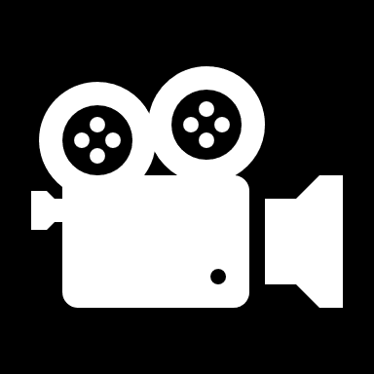
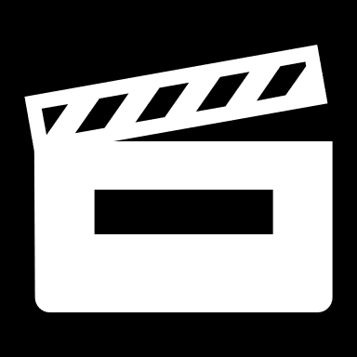
Applications in Industry
Video Synthesis
Frame-by-frame denoising enables realistic video generation.
Notes:
Key Point: Diffusion models have a wide range of applications, powering image synthesis (e.g. DALL·E 2, Stable Diffusion, Google Imagen for creating art and photorealistic images), audio generation (e.g. WaveGrad, DiffWave for text-to-speech and music), aiding drug discovery (by generating novel molecular structures), and even video synthesis (creating short videos via frame-by-frame generative diffusion).
Detailed Explanation: Highlight how diffusion models are not just academic—they’re already driving real products and research in various industries:
Image Synthesis: This is perhaps the most well-known application. Diffusion models are the engine behind many AI image generators. For example, OpenAI’s DALL·E 2 uses a diffusion prior and decoder to generate images from text descriptions. Stable Diffusion, an open-source model, uses a latent diffusion approach to generate images and has been widely adopted in applications (from art generation tools to image editing software). Google’s Imagen and Parti are diffusion-based models that produce high-fidelity images from text prompts. Emphasize the impact: these systems can create images that often look like photographs or human-drawn art, given just a description – something that was barely possible a few years ago. Companies are now integrating these for creative tools, marketing (to generate ad visuals), and more. The reason diffusion models dominate here is their ability to produce high-resolution, detailed images with fewer artifacts than earlier GAN approaches.
Audio Generation: Diffusion models are also used in generating audio, particularly speech and music. Projects like WaveGrad (by Google) and DiffWave (by NVIDIA) have applied diffusion to text-to-speech, where the task is to generate a waveform of human speech from text. They treat an audio waveform like a 1-D signal and add noise to it, then train a model to remove noise. The results are highly natural-sounding voices. Another domain is music generation or enhancement: diffusion models can be used to generate musical audio or to restore audio (e.g., removing noise from recordings, much like image denoising but for sound). The advantage in audio is similar to images: diffusion model training is stable and doesn’t suffer from mode collapse, so it can capture a wide variety of sounds. Startups and research labs are exploring these for creating background music, voice cloning, or improving audio quality in calls.
Drug Discovery (Molecular Generation): In the pharmaceutical industry, there’s interest in generating novel chemical compounds (molecules) that could serve as new drugs. Diffusion models have been brought into this domain by representing molecules in some continuous form (for instance, as graphs or 3D point clouds of atoms) and then adding noise to these representations. A diffusion model can then generate new molecular structures by removing noise. The slide alludes to molecular structure generation and optimization. For example, a model might generate candidate molecules that bind to a certain protein target by being guided (this is a conditional generation where the condition is some desired property). Companies like Insilico Medicine and Genentech have been experimenting with such generative models for drug design. The key point is that diffusion models provide a way to explore the space of chemicals more broadly and with fewer biases than methods before. It’s a promising application where these models could significantly speed up the early stages of drug discovery by proposing candidates that chemists can then synthesize and test.
Video Synthesis: Generating video is extremely challenging because of the temporal consistency required (each frame should logically follow the previous). Diffusion models are being extended to video by essentially treating video frames as a sequence of images and adding noise over time. One approach is frame-by-frame denoising: you generate the first frame with diffusion, then condition the generation of the second frame on the first (to maintain consistency), and so on. Another approach is to treat the whole video as a 3D block of data (x, y, time) and diffuse that, but that’s very computationally heavy. Early works like Video Diffusion Models (by Ho et al.) or projects like Imagen Video (by Google) use diffusion to create short video clips. They often generate low-resolution videos first and then refine them (multi-scale approach). Mention that results are nascent but promising – you can get a few seconds of coherent video of, say, “a teddy bear painting a portrait” or some imaginative prompt. While far from perfect, this application could transform industries like entertainment and simulation (imagine generating quick previews of scenes, or augmenting video editing). It’s an example of how diffusion’s power in images is being scaled to an even more complex domain.
Finally, you can note that these are just the highlighted domains. There are other emerging uses: text (diffusion models for generating text or code, often combined with language models), anomaly detection (using diffusion models to model normal data and detect anomalies by reconstruction error), and more. The take-home for this slide is that diffusion models are versatile; thanks to their flexibility and quality, they’re being applied anywhere we need to generate or restore complex data.

Slide 24
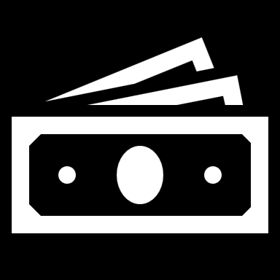
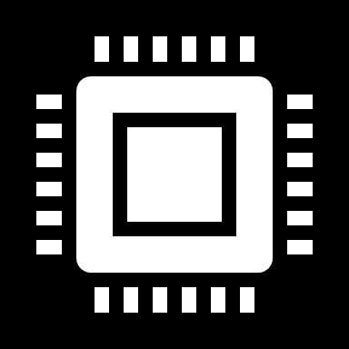
Challenges and Future Directions
Computational Cost
High memory and time requirements limit large-scale adoption.
Notes:
Key Point: Diffusion models are extremely powerful, but they come with challenges: they require a lot of computation (both for training and sampling, making them slower than alternatives), and while they mitigate mode collapse compared to GANs, efficiency and scalability issues remain. Future efforts focus on reducing computation and latency (faster sampling, model compression) and improving scalability to make diffusion models more practical for widespread use.
Detailed Explanation: Acknowledge that as great as diffusion models are, there are important challenges to overcome:
Computational Cost (Memory and Compute): Training diffusion models is computationally intensive. Each training iteration might involve running a large U-Net hundreds of times (for different timesteps or with large batch sizes covering multiple timesteps). For example, the original diffusion models for high-res images required multiple GPUs for many days. The memory usage is high because of storing many feature maps and, if using very deep models or attention mechanisms, it grows further. This high cost limits who can train these models (mostly large companies or labs). It also means models like Stable Diffusion or DALL·E 2 were expensive to develop. Inference (generation) is also heavy: generating one image might take a couple of seconds on a high-end GPU, whereas a GAN could do it in a fraction of a second. For deployment, this is a problem – imagine an app that needs to generate images in real-time; using a naive diffusion model would be too slow.
Sampling Speed: As noted, diffusion models are generally slower than GANs or other generators because of the iterative process. Even with improvements like DDIM, you often need tens of neural network evaluations for one sample. This is fine for offline generation (like rendering a piece of art), but it’s a hurdle for interactive systems or very large-scale generation (think of generating millions of images for a dataset or video frames for a long video). A lot of current research is about closing this gap – for example, one approach is knowledge distillation where you train a smaller model to mimic the multi-step process in fewer steps (some recent papers managed to compress 1000 steps into e.g. 1 or 10 steps effectively). Another approach is to find better samplers mathematically (combining big jumps with little corrective steps). There’s also exploration in model architectures that can generate in fewer steps inherently (like a model that outputs several time steps at once). This challenge is well recognized: diffusion models need to be faster to truly match the ease of use of something like GANs in production.
Mode Collapse and Diversity: One selling point of diffusion models is they dodge mode collapse issues that plague GANs​medium.com
. Because they are trained with a likelihood-based objective, they are incentivized to model the entire data distribution. Also, each sampling involves randomness at each step (if sampling stochastically), which helps in getting varied outputs. However, mode collapse can still creep in in subtle ways. For instance, if one uses extremely strong classifier-free guidance to improve image quality, it can start limiting diversity (the samples might become too similar or omit some variety present in the training data). Also, if the model or training data is biased, it might effectively collapse to those biases (e.g., always generating similar-looking faces if that’s common in training). But compared to GANs, diffusion models indeed exhibit much more robust coverage of the data distribution – they spread attention across modes “by taking it slow and steady” in the generation process​medium.com
. So, the issue is not a severe collapse, but ensuring they maintain diversity especially under guided generation scenarios is an area of focus.
Scalability: By scalability, we mean both scaling up and scaling down. Scaling up: Can we train diffusion models on massive datasets and higher resolutions efficiently? For instance, what about generating 4K images or full-length movies, or training on billions of images (as some companies are doing with language models)? This will require algorithmic and hardware innovations to manage the sheer size. We already see progress: latent diffusion was one answer to scaling to high-res images. In the future, maybe distributed diffusion models or mixture-of-experts could appear to handle even bigger tasks. Scaling down: On the flip side, can we run diffusion models on edge devices (phones, browsers)? Right now, doing 50 neural net passes for a single output on a phone is borderline – it can drain battery and be slow. There is work on optimizing models, quantizing them (reducing precision to make them faster), or using knowledge distillation to create smaller models that approximate the large ones. For instance, some developers have managed to get simplified versions of Stable Diffusion running on mobile by sacrificing some quality for speed. Another angle is efficient architectures: researchers are looking at replacing the U-Net with something like a Transformer or a combination that might be more efficient, or using novel layers that are faster on certain hardware.
Other Challenges: You can briefly mention other concerns like memory footprint (diffusion models with attention layers can blow up in memory as image size grows, so memory-efficient attention is a topic), and evaluation (since they are probabilistic models, how to best evaluate and compare them beyond FID/Inception score is an open question; also the ELBO doesn’t directly correlate with perceptual quality).
Future Directions: Having laid out the challenges, say that the future research directions are naturally aimed at solving these issues. Expect to see a lot of work on speeding up sampling – possibly achieving diffusion-quality generation in just a few steps (there’s already progress with e.g. DDIM, EDM, etc.). We also anticipate more use of hybrid models (like combining diffusion with GANs or VAEs) to leverage the strengths of each. Another direction is better theoretical understanding – bridging the gap between the discrete diffusion and continuous formulations, understanding the limits of guidance, etc., which could inform new techniques. Finally, mention that making diffusion models more accessible and eco-friendly (less energy consumption) is important for their sustainable deployment. The community is very actively addressing these challenges because diffusion models have so much potential – so we want to deploy them widely, and that means making them efficient and scalable. This is an exciting area where we’ll likely see rapid improvements in the next couple of years.

Slide 25


Challenges and Future Directions
Sampling Speed
Diffusion models are slower than GANs, requiring optimization for real-time applications.
Notes:
Key Point: Diffusion models are extremely powerful, but they come with challenges: they require a lot of computation (both for training and sampling, making them slower than alternatives), and while they mitigate mode collapse compared to GANs, efficiency and scalability issues remain. Future efforts focus on reducing computation and latency (faster sampling, model compression) and improving scalability to make diffusion models more practical for widespread use.
Detailed Explanation: Acknowledge that as great as diffusion models are, there are important challenges to overcome:
Computational Cost (Memory and Compute): Training diffusion models is computationally intensive. Each training iteration might involve running a large U-Net hundreds of times (for different timesteps or with large batch sizes covering multiple timesteps). For example, the original diffusion models for high-res images required multiple GPUs for many days. The memory usage is high because of storing many feature maps and, if using very deep models or attention mechanisms, it grows further. This high cost limits who can train these models (mostly large companies or labs). It also means models like Stable Diffusion or DALL·E 2 were expensive to develop. Inference (generation) is also heavy: generating one image might take a couple of seconds on a high-end GPU, whereas a GAN could do it in a fraction of a second. For deployment, this is a problem – imagine an app that needs to generate images in real-time; using a naive diffusion model would be too slow.
Sampling Speed: As noted, diffusion models are generally slower than GANs or other generators because of the iterative process. Even with improvements like DDIM, you often need tens of neural network evaluations for one sample. This is fine for offline generation (like rendering a piece of art), but it’s a hurdle for interactive systems or very large-scale generation (think of generating millions of images for a dataset or video frames for a long video). A lot of current research is about closing this gap – for example, one approach is knowledge distillation where you train a smaller model to mimic the multi-step process in fewer steps (some recent papers managed to compress 1000 steps into e.g. 1 or 10 steps effectively). Another approach is to find better samplers mathematically (combining big jumps with little corrective steps). There’s also exploration in model architectures that can generate in fewer steps inherently (like a model that outputs several time steps at once). This challenge is well recognized: diffusion models need to be faster to truly match the ease of use of something like GANs in production.
Mode Collapse and Diversity: One selling point of diffusion models is they dodge mode collapse issues that plague GANs​medium.com
. Because they are trained with a likelihood-based objective, they are incentivized to model the entire data distribution. Also, each sampling involves randomness at each step (if sampling stochastically), which helps in getting varied outputs. However, mode collapse can still creep in in subtle ways. For instance, if one uses extremely strong classifier-free guidance to improve image quality, it can start limiting diversity (the samples might become too similar or omit some variety present in the training data). Also, if the model or training data is biased, it might effectively collapse to those biases (e.g., always generating similar-looking faces if that’s common in training). But compared to GANs, diffusion models indeed exhibit much more robust coverage of the data distribution – they spread attention across modes “by taking it slow and steady” in the generation process​medium.com
. So, the issue is not a severe collapse, but ensuring they maintain diversity especially under guided generation scenarios is an area of focus.
Scalability: By scalability, we mean both scaling up and scaling down. Scaling up: Can we train diffusion models on massive datasets and higher resolutions efficiently? For instance, what about generating 4K images or full-length movies, or training on billions of images (as some companies are doing with language models)? This will require algorithmic and hardware innovations to manage the sheer size. We already see progress: latent diffusion was one answer to scaling to high-res images. In the future, maybe distributed diffusion models or mixture-of-experts could appear to handle even bigger tasks. Scaling down: On the flip side, can we run diffusion models on edge devices (phones, browsers)? Right now, doing 50 neural net passes for a single output on a phone is borderline – it can drain battery and be slow. There is work on optimizing models, quantizing them (reducing precision to make them faster), or using knowledge distillation to create smaller models that approximate the large ones. For instance, some developers have managed to get simplified versions of Stable Diffusion running on mobile by sacrificing some quality for speed. Another angle is efficient architectures: researchers are looking at replacing the U-Net with something like a Transformer or a combination that might be more efficient, or using novel layers that are faster on certain hardware.
Other Challenges: You can briefly mention other concerns like memory footprint (diffusion models with attention layers can blow up in memory as image size grows, so memory-efficient attention is a topic), and evaluation (since they are probabilistic models, how to best evaluate and compare them beyond FID/Inception score is an open question; also the ELBO doesn’t directly correlate with perceptual quality).
Future Directions: Having laid out the challenges, say that the future research directions are naturally aimed at solving these issues. Expect to see a lot of work on speeding up sampling – possibly achieving diffusion-quality generation in just a few steps (there’s already progress with e.g. DDIM, EDM, etc.). We also anticipate more use of hybrid models (like combining diffusion with GANs or VAEs) to leverage the strengths of each. Another direction is better theoretical understanding – bridging the gap between the discrete diffusion and continuous formulations, understanding the limits of guidance, etc., which could inform new techniques. Finally, mention that making diffusion models more accessible and eco-friendly (less energy consumption) is important for their sustainable deployment. The community is very actively addressing these challenges because diffusion models have so much potential – so we want to deploy them widely, and that means making them efficient and scalable. This is an exciting area where we’ll likely see rapid improvements in the next couple of years.

Slide 26
Challenges and Future Directions
Mode Collapse
Less frequent than in GANs, but still an issue in certain implementations.
Notes:
Key Point: Diffusion models are extremely powerful, but they come with challenges: they require a lot of computation (both for training and sampling, making them slower than alternatives), and while they mitigate mode collapse compared to GANs, efficiency and scalability issues remain. Future efforts focus on reducing computation and latency (faster sampling, model compression) and improving scalability to make diffusion models more practical for widespread use.
Detailed Explanation: Acknowledge that as great as diffusion models are, there are important challenges to overcome:
Computational Cost (Memory and Compute): Training diffusion models is computationally intensive. Each training iteration might involve running a large U-Net hundreds of times (for different timesteps or with large batch sizes covering multiple timesteps). For example, the original diffusion models for high-res images required multiple GPUs for many days. The memory usage is high because of storing many feature maps and, if using very deep models or attention mechanisms, it grows further. This high cost limits who can train these models (mostly large companies or labs). It also means models like Stable Diffusion or DALL·E 2 were expensive to develop. Inference (generation) is also heavy: generating one image might take a couple of seconds on a high-end GPU, whereas a GAN could do it in a fraction of a second. For deployment, this is a problem – imagine an app that needs to generate images in real-time; using a naive diffusion model would be too slow.
Sampling Speed: As noted, diffusion models are generally slower than GANs or other generators because of the iterative process. Even with improvements like DDIM, you often need tens of neural network evaluations for one sample. This is fine for offline generation (like rendering a piece of art), but it’s a hurdle for interactive systems or very large-scale generation (think of generating millions of images for a dataset or video frames for a long video). A lot of current research is about closing this gap – for example, one approach is knowledge distillation where you train a smaller model to mimic the multi-step process in fewer steps (some recent papers managed to compress 1000 steps into e.g. 1 or 10 steps effectively). Another approach is to find better samplers mathematically (combining big jumps with little corrective steps). There’s also exploration in model architectures that can generate in fewer steps inherently (like a model that outputs several time steps at once). This challenge is well recognized: diffusion models need to be faster to truly match the ease of use of something like GANs in production.
Mode Collapse and Diversity: One selling point of diffusion models is they dodge mode collapse issues that plague GANs​medium.com
. Because they are trained with a likelihood-based objective, they are incentivized to model the entire data distribution. Also, each sampling involves randomness at each step (if sampling stochastically), which helps in getting varied outputs. However, mode collapse can still creep in in subtle ways. For instance, if one uses extremely strong classifier-free guidance to improve image quality, it can start limiting diversity (the samples might become too similar or omit some variety present in the training data). Also, if the model or training data is biased, it might effectively collapse to those biases (e.g., always generating similar-looking faces if that’s common in training). But compared to GANs, diffusion models indeed exhibit much more robust coverage of the data distribution – they spread attention across modes “by taking it slow and steady” in the generation process​medium.com
. So, the issue is not a severe collapse, but ensuring they maintain diversity especially under guided generation scenarios is an area of focus.
Scalability: By scalability, we mean both scaling up and scaling down. Scaling up: Can we train diffusion models on massive datasets and higher resolutions efficiently? For instance, what about generating 4K images or full-length movies, or training on billions of images (as some companies are doing with language models)? This will require algorithmic and hardware innovations to manage the sheer size. We already see progress: latent diffusion was one answer to scaling to high-res images. In the future, maybe distributed diffusion models or mixture-of-experts could appear to handle even bigger tasks. Scaling down: On the flip side, can we run diffusion models on edge devices (phones, browsers)? Right now, doing 50 neural net passes for a single output on a phone is borderline – it can drain battery and be slow. There is work on optimizing models, quantizing them (reducing precision to make them faster), or using knowledge distillation to create smaller models that approximate the large ones. For instance, some developers have managed to get simplified versions of Stable Diffusion running on mobile by sacrificing some quality for speed. Another angle is efficient architectures: researchers are looking at replacing the U-Net with something like a Transformer or a combination that might be more efficient, or using novel layers that are faster on certain hardware.
Other Challenges: You can briefly mention other concerns like memory footprint (diffusion models with attention layers can blow up in memory as image size grows, so memory-efficient attention is a topic), and evaluation (since they are probabilistic models, how to best evaluate and compare them beyond FID/Inception score is an open question; also the ELBO doesn’t directly correlate with perceptual quality).
Future Directions: Having laid out the challenges, say that the future research directions are naturally aimed at solving these issues. Expect to see a lot of work on speeding up sampling – possibly achieving diffusion-quality generation in just a few steps (there’s already progress with e.g. DDIM, EDM, etc.). We also anticipate more use of hybrid models (like combining diffusion with GANs or VAEs) to leverage the strengths of each. Another direction is better theoretical understanding – bridging the gap between the discrete diffusion and continuous formulations, understanding the limits of guidance, etc., which could inform new techniques. Finally, mention that making diffusion models more accessible and eco-friendly (less energy consumption) is important for their sustainable deployment. The community is very actively addressing these challenges because diffusion models have so much potential – so we want to deploy them widely, and that means making them efficient and scalable. This is an exciting area where we’ll likely see rapid improvements in the next couple of years.

Slide 27
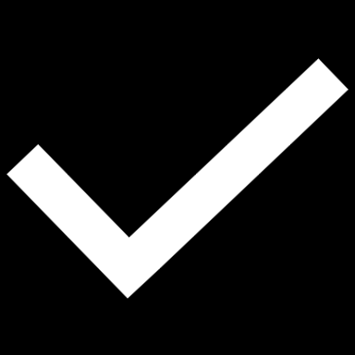
Challenges and Future Directions
Scalability
Efforts focus on making training and inference more efficient.
Notes:
Key Point: Diffusion models are extremely powerful, but they come with challenges: they require a lot of computation (both for training and sampling, making them slower than alternatives), and while they mitigate mode collapse compared to GANs, efficiency and scalability issues remain. Future efforts focus on reducing computation and latency (faster sampling, model compression) and improving scalability to make diffusion models more practical for widespread use.
Detailed Explanation: Acknowledge that as great as diffusion models are, there are important challenges to overcome:
Computational Cost (Memory and Compute): Training diffusion models is computationally intensive. Each training iteration might involve running a large U-Net hundreds of times (for different timesteps or with large batch sizes covering multiple timesteps). For example, the original diffusion models for high-res images required multiple GPUs for many days. The memory usage is high because of storing many feature maps and, if using very deep models or attention mechanisms, it grows further. This high cost limits who can train these models (mostly large companies or labs). It also means models like Stable Diffusion or DALL·E 2 were expensive to develop. Inference (generation) is also heavy: generating one image might take a couple of seconds on a high-end GPU, whereas a GAN could do it in a fraction of a second. For deployment, this is a problem – imagine an app that needs to generate images in real-time; using a naive diffusion model would be too slow.
Sampling Speed: As noted, diffusion models are generally slower than GANs or other generators because of the iterative process. Even with improvements like DDIM, you often need tens of neural network evaluations for one sample. This is fine for offline generation (like rendering a piece of art), but it’s a hurdle for interactive systems or very large-scale generation (think of generating millions of images for a dataset or video frames for a long video). A lot of current research is about closing this gap – for example, one approach is knowledge distillation where you train a smaller model to mimic the multi-step process in fewer steps (some recent papers managed to compress 1000 steps into e.g. 1 or 10 steps effectively). Another approach is to find better samplers mathematically (combining big jumps with little corrective steps). There’s also exploration in model architectures that can generate in fewer steps inherently (like a model that outputs several time steps at once). This challenge is well recognized: diffusion models need to be faster to truly match the ease of use of something like GANs in production.
Mode Collapse and Diversity: One selling point of diffusion models is they dodge mode collapse issues that plague GANs​medium.com
. Because they are trained with a likelihood-based objective, they are incentivized to model the entire data distribution. Also, each sampling involves randomness at each step (if sampling stochastically), which helps in getting varied outputs. However, mode collapse can still creep in in subtle ways. For instance, if one uses extremely strong classifier-free guidance to improve image quality, it can start limiting diversity (the samples might become too similar or omit some variety present in the training data). Also, if the model or training data is biased, it might effectively collapse to those biases (e.g., always generating similar-looking faces if that’s common in training). But compared to GANs, diffusion models indeed exhibit much more robust coverage of the data distribution – they spread attention across modes “by taking it slow and steady” in the generation process​medium.com
. So, the issue is not a severe collapse, but ensuring they maintain diversity especially under guided generation scenarios is an area of focus.
Scalability: By scalability, we mean both scaling up and scaling down. Scaling up: Can we train diffusion models on massive datasets and higher resolutions efficiently? For instance, what about generating 4K images or full-length movies, or training on billions of images (as some companies are doing with language models)? This will require algorithmic and hardware innovations to manage the sheer size. We already see progress: latent diffusion was one answer to scaling to high-res images. In the future, maybe distributed diffusion models or mixture-of-experts could appear to handle even bigger tasks. Scaling down: On the flip side, can we run diffusion models on edge devices (phones, browsers)? Right now, doing 50 neural net passes for a single output on a phone is borderline – it can drain battery and be slow. There is work on optimizing models, quantizing them (reducing precision to make them faster), or using knowledge distillation to create smaller models that approximate the large ones. For instance, some developers have managed to get simplified versions of Stable Diffusion running on mobile by sacrificing some quality for speed. Another angle is efficient architectures: researchers are looking at replacing the U-Net with something like a Transformer or a combination that might be more efficient, or using novel layers that are faster on certain hardware.
Other Challenges: You can briefly mention other concerns like memory footprint (diffusion models with attention layers can blow up in memory as image size grows, so memory-efficient attention is a topic), and evaluation (since they are probabilistic models, how to best evaluate and compare them beyond FID/Inception score is an open question; also the ELBO doesn’t directly correlate with perceptual quality).
Future Directions: Having laid out the challenges, say that the future research directions are naturally aimed at solving these issues. Expect to see a lot of work on speeding up sampling – possibly achieving diffusion-quality generation in just a few steps (there’s already progress with e.g. DDIM, EDM, etc.). We also anticipate more use of hybrid models (like combining diffusion with GANs or VAEs) to leverage the strengths of each. Another direction is better theoretical understanding – bridging the gap between the discrete diffusion and continuous formulations, understanding the limits of guidance, etc., which could inform new techniques. Finally, mention that making diffusion models more accessible and eco-friendly (less energy consumption) is important for their sustainable deployment. The community is very actively addressing these challenges because diffusion models have so much potential – so we want to deploy them widely, and that means making them efficient and scalable. This is an exciting area where we’ll likely see rapid improvements in the next couple of years.

Slide 28


Conclusion
Key Takeaways
Diffusion models are powerful generative models with high-quality outputs, but efficiency improvements are needed.
Notes:
Key Point: Key Takeaways: Diffusion models have become a powerful paradigm for generative modeling, capable of producing remarkably high-quality and diverse outputs. Future Research: The focus is now on making these models more efficient (faster sampling, less resource-intensive) and scalable to new domains and real-world deployment.
Detailed Explanation: Wrap up the talk by summarizing what we’ve learned. First, reinforce the key insights about diffusion models:
They are conceptually inspired by physical diffusion and formulated as a sequential noising-denoising process.
They train in a straightforward, stable way (no adversarial trickery, which plagued GANs) by predicting noise, which leads to reliable convergence and excellent results.
They’ve demonstrated state-of-the-art performance in image generation and other areas, producing outputs that can be indistinguishable from real data in many cases.
They offer flexibility in conditioning, meaning we can guide them to generate what we want (which is hugely useful).
Importantly, they generally avoid the pitfalls of mode collapse, giving us diverse outputs covering the data distribution.
These points highlight why diffusion models are a big deal in the AI community. They’ve essentially redefined the state-of-the-art for generative models in the last couple of years, leading some to say they “outperformed GANs” and possibly might replace some other approaches for many tasks.
Next, look to the future. Acknowledge that while diffusion models are excellent, they are not perfect or final. There’s active research aimed at improving efficiency – for example, one hot area is reducing the number of steps needed for generation (as we discussed). If in a year or two we have diffusion models that can generate with, say, 1–10 steps without loss of quality, that would be a huge breakthrough (making them as fast as, or faster than, current methods). Another area is model compression and optimization: finding ways to prune or distill these huge U-Nets into smaller models that run faster and use less memory. We might see specialized hardware or libraries that optimize the many small steps of diffusion into fused operations. On the research side, there’s also interest in exploring new domains – perhaps diffusion models for 3D generation (there are already works on generating 3D point clouds or NeRFs via diffusion), for multimodal tasks (combining text, images, audio in one model), etc. Each new domain might pose new challenges (e.g., 3D structure consistency), which will drive innovations. Another future direction is integrating diffusion models with other AI systems: for example, using diffusion models inside larger pipelines (like using a diffusion model to refine outputs of a faster but lower-quality model, combining it with retrieval systems, or using it in an RL setting to imagine outcomes).
End on a positive and enthusiastic note: Diffusion models have opened up exciting possibilities in AI. They exemplify how drawing ideas from different fields (physics, graphical models, deep learning) can result in a powerful new approach. With ongoing research addressing speed and efficiency, we can expect diffusion models to become even more impactful, perhaps becoming commonplace in deployed applications from creative tools to scientific research. Thank the audience for their attention and interest in this journey from fundamentals to the cutting edge of diffusion models.

Slide 29

Conclusion
Future Research
Research focuses on making them faster, scalable, and applicable to real-world scenarios.
Notes:
Key Point: Thank the audience for listening, and invite any questions or discussion about diffusion models.
Detailed Explanation: Conclude the presentation by expressing gratitude to the audience for their time and attention. Acknowledge that diffusion models are a complex topic and that you covered a lot of ground, from basic concepts to advanced ideas. Encourage the audience to ask questions – whether it’s a clarification of something basic (like “what is ELBO?” or “why Gaussian noise?”) or a deeper discussion on advanced topics (such as implementation tricks or recent research papers). If there were questions raised during the talk that you promised to address later, now is the time to tackle them. You might also pose a question back to the audience to stimulate discussion (e.g., “What applications of diffusion models are you most excited or concerned about?”) to engage both beginners and experts in the room. Conclude by reiterating that diffusion models are a fascinating and rapidly evolving area of AI. Thank everyone again for being part of the session, and let them know you’re open to discussion now and even after the session (for those who might want to chat one-on-one). This wrap-up ensures the session ends on an interactive and appreciative note.

Slide 30


Thank You!
Final Slide
Q&A and further discussion.

